Slide 1
Responding to the Economic Impacts of Coronavirus: A Proposed Oregon Economic Recovery and Resilience Framework
Robert Parker
Institute for policy research and engagement University of Oregon

Slide 2
Robert Parker Executive Director
Institute for Policy Research & Engagement
School of Planning, Public Policy & Management
University of Oregon

Slide 3
Imagine that Oregon’s economic development community embraces a consistent and wholistic strategy to coordinate implementation of economic recovery efforts across lines: public and private, local and state, urban and rural. What benefits would that bring and what organizational framework would support it?

Slide 4
Phases of the Coronavirus Pandemic
March – June (optimistically), when we may see loosening of stay-at-home orders. |  | June through, perhaps, December, as businesses seek to resume operations. Intermittent or targeted partial shutdowns might continue. |  | December through the dissemination of a vaccine and perhaps beyond (1 – 3 years). How soon businesses reopen and people can start spending will largely determine the length and depth of the recovery phase.
The Shutdown
The Reopening
The Recovery

Slide 5
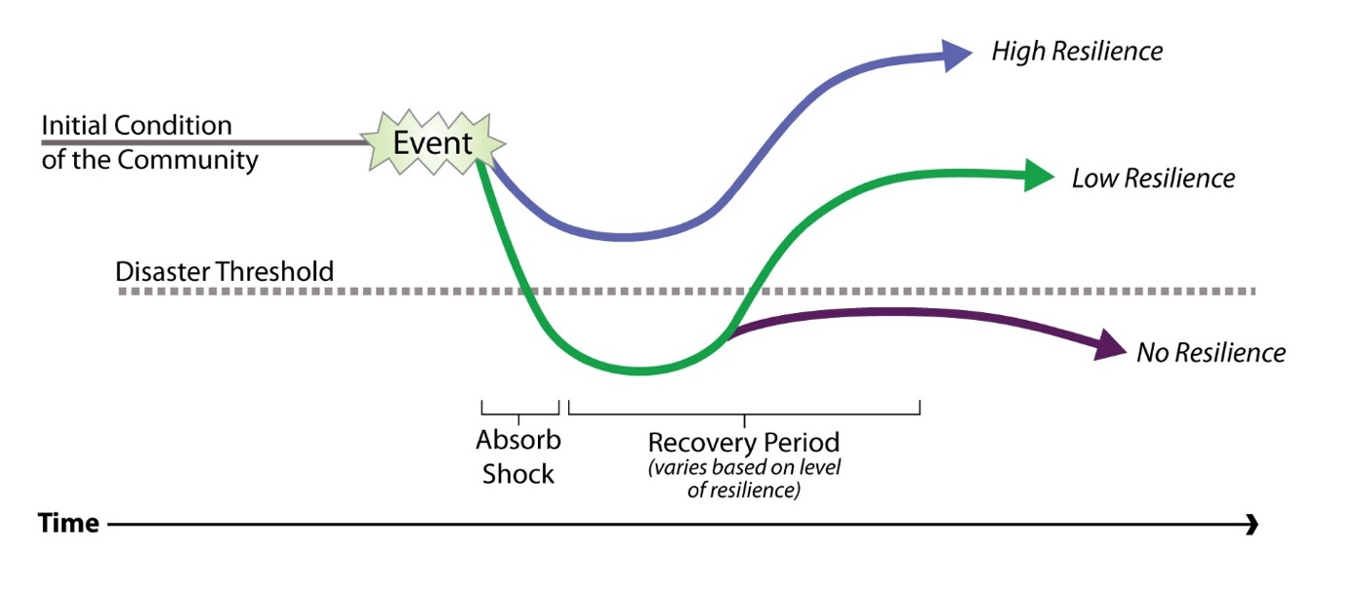
Resilience & Recovery Trajectories

Slide 6
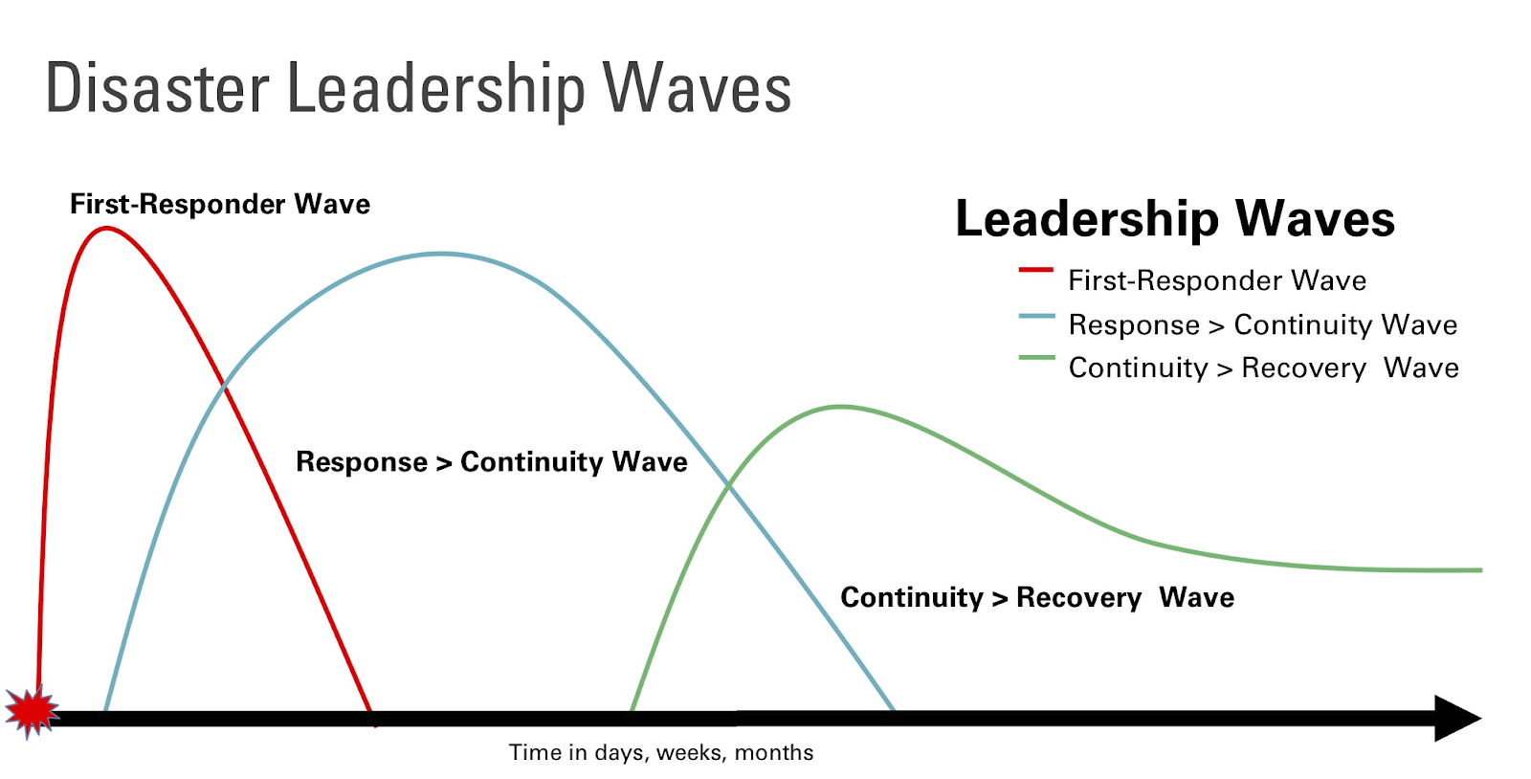

Slide 7
Recommended Organizational Structure For Recovery
Establish separate, but linked organizational structures that can lead response, continuity, and recovery efforts.
Identify clear, centralized regional leadership for economic continuity and recovery efforts to report up to the State Disaster Recovery Coordinator.
Activate State Economic Recovery Support Functions and establish a group mandated to plan for continuity and recovery.
Convene regional economic continuity and recovery teams and get this work moving ASAP.
Develop a clear playbook of actions to coordinate efforts of all actors in the economic development ecosystem.

Slide 9
Identifying And Prioritizing Action
Given an assessment of industry and economic development challenges, what recovery outcomes should we be striving for?
What activities will have the biggest impact?
What priorities should exist to support the most impactful recovery outcomes?
How can local governments deploy federal, state, and local investments in a coordinated effort to achieve agreed-upon recovery outcomes and meaningful impacts?
How do we mobilize networks for action?

Slide 10
Where to start?
Continue response: get the federal money out
Mobilize for continuity and recovery action
Map your assets
Analyze areas of risk
Apply principles of agile strategy
Get started!

Slide 11
Josh Bruce jdbruce@uoregon.edu
Robert Parker
rgp@uoregon.edu
Matt Craigie
craigie@econw.com

