Slide 1
Western Governors Association
Improving Airports and Air Service Webinar
April 21, 2020
Presented by: David Short
Deputy Assistant Secretary
Aviation and International Affairs

Slide 2
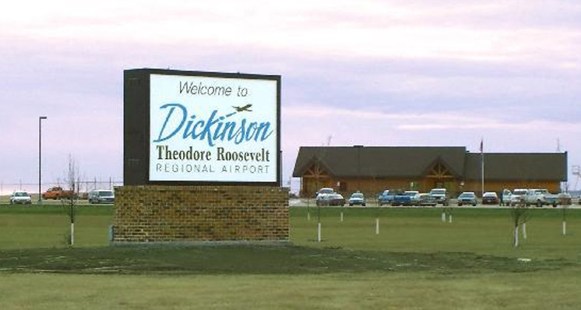
Essential Air Service

Slide 3
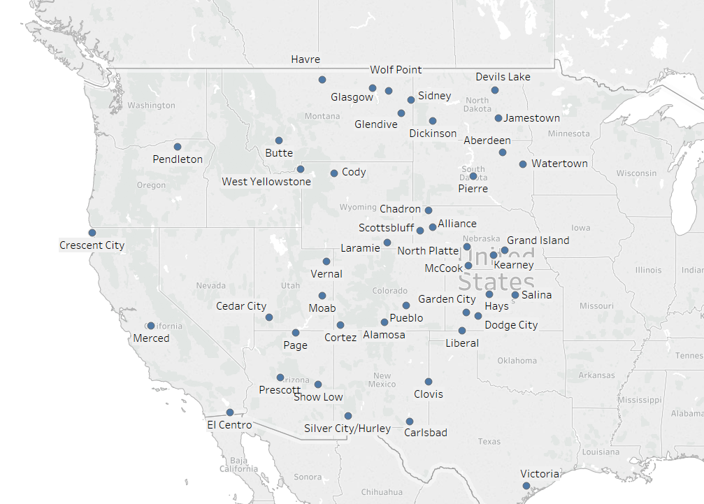
Western US EAS communities

Slide 4
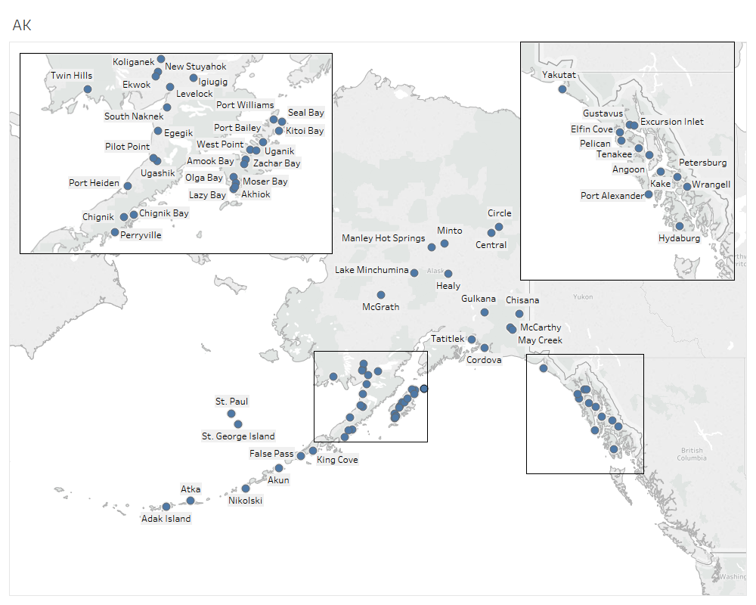
EAS communities in Alaska

Slide 5
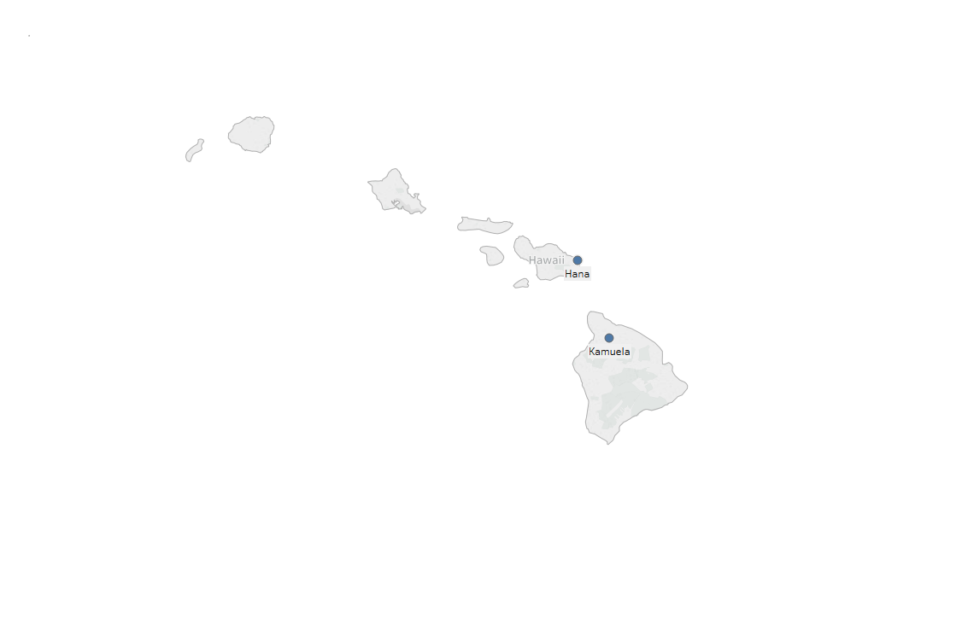
EAS communities in Hawaii

Slide 6
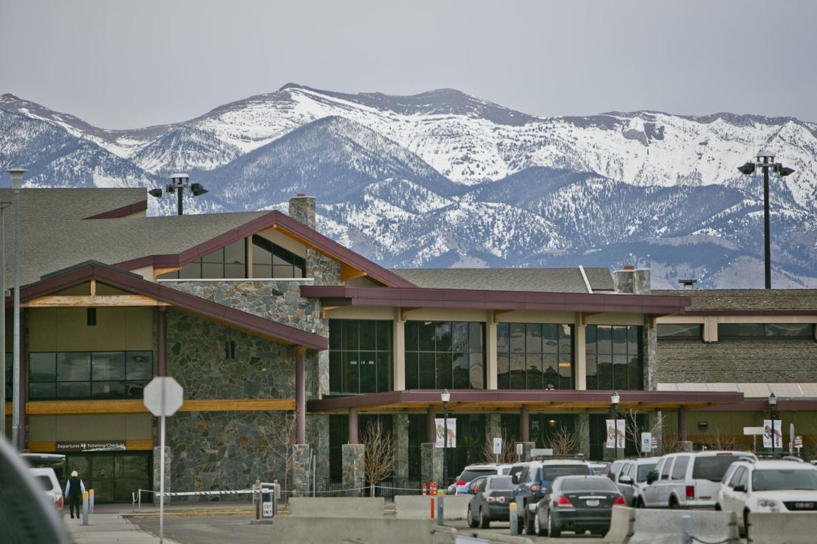
Small Community Air Service Development Program (SCASDP)
Bozeman International Airport

