Slide 1
www.nbaa.org
Notes:
Slide 1: Cover
Good morning. Thanks for giving me this opportunity to talk to you about the industry I work in: business aviation.
As you know, I work for NBAA, the National Business Aviation Association, and we represent companies across America using airplanes for business.
Through the No Plane No Gain program, we and other aviation organizations make resources like this deck widely available. Our goal is to help people get to know our industry.
It’s an industry that’s sometimes not well understood, but it touches many more people than you might think.

Slide 2
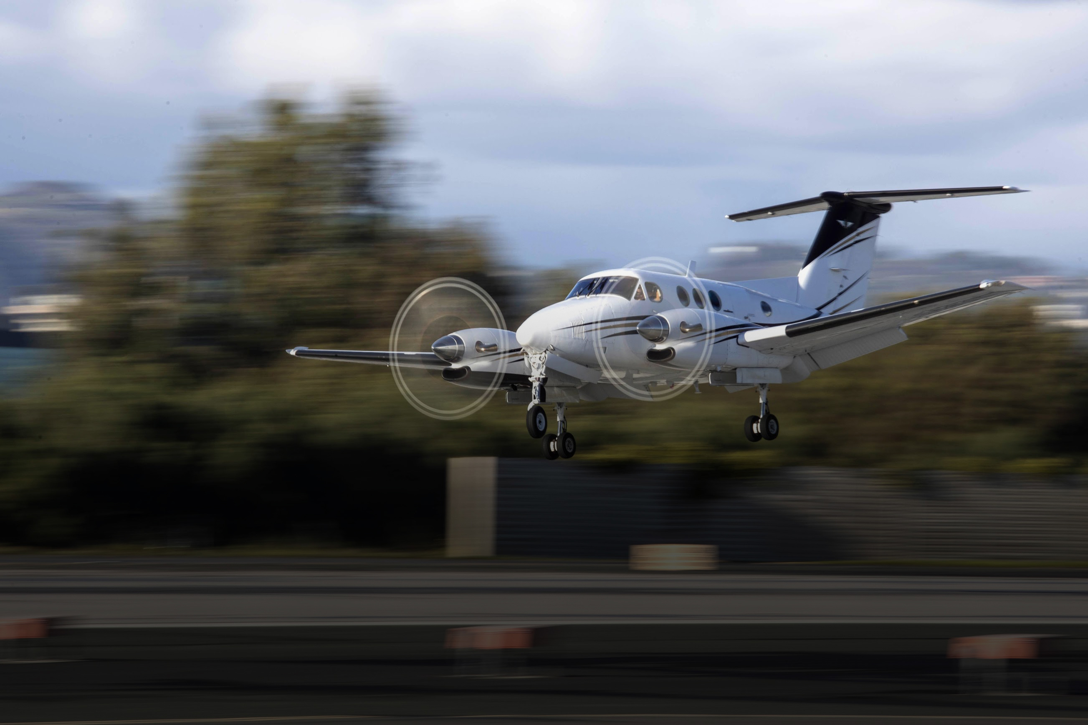
WHAT IS BUSINESS AVIATION?
www.nbaa.org
Notes:
Slide 2: What Is Business Aviation?
It’s also not very complicated: business aviation is the manufacture and use of mostly small airplanes for business transportation.
Companies of all sizes have been using business airplanes for decades. My organization, NBAA, was founded back in 1947 to foster an environment that allows these companies to thrive.

Slide 3
MANY TYPES of AIRCRAFT
www.nbaa.org
Notes:
Slide 3: Many Types of Aircraft
I say small airplanes, because business aircraft are about the size of a large SUV inside, carrying about 6 passengers. They are often turboprop or piston-driven airplanes.
While the industry takes in aircraft of all sizes, more than 50% of all business aircraft in America are turboprops or smaller jets.

Slide 4
MANY USES
www.nbaa.org
Notes:
Slide 4: Many Uses
Companies and organizations of all kinds and sizes use these aircraft. So do schools, universities and nonprofit organizations. Many federal, state and local government agencies, too.
In many states, the departments of public safety, fish and wildlife and transportation operate small Cessna 182s or Pilatus PC-12s.
And then, of course there’s law enforcement and fire-fighting.
But you might be surprised that many of the companies with an aircraft are small businesses.
In fact, 45% of the companies using business aviation in the U.S. have fewer than 500 employees.

Slide 5
MANY USES
www.nbaa.org
Notes:
Slide 4: Many Uses VIDEO
Let me show you a video of some companies that use business aircraft.
[Proceed to next slide to play video]

Slide 6
MANY FACES
www.nbaa.org
Notes:
Slide 7: Many Faces
The other side of this industry that’s very diverse is the people working in it.
In thousands of towns across America, business aviation supports more than 1 million jobs.
Maintenance technicians, engineers, dispatchers who plan trips and flight schedules, pilots, flight attendants… line technicians who fuel, clean and marshal aircraft.
And of course aircraft brokers, financial advisers, lawyers, and insurers who help make sure the aircraft is operated safely.

Slide 7
MANY BENEFITS
www.nbaa.org
Notes:
Slide 8: Many Benefits
With all these high-skilled jobs, all across the country, business aviation is one of America’s most dynamic industries.
It adds $200 billion to our economy every year.
And many business aircraft are made right here in America. We’re a leader in aircraft manufacturing, making a big positive impact on our balance of trade.

Slide 8
CONNECTING COMMUNITIES
www.nbaa.org
Notes:
Slide 11: Connecting Communities
Day-to-day, what business aviation is all about is connecting communities.
There are over 5,000 public airports in this country. But the commercial airlines serve fewer than 500 of them. And many of even those are small, rural airports with limited service. Maybe two flights a day.
For thousands of other towns and rural communities across America, their link to the world is a general aviation airport.
They depend on that airport – and business aircraft – for mail and cargo shipping, first responder missions and business connections.
In fact, over 41% of business aircraft are flown into these towns with little or no airline service.
It’s what enables an S&P 500 software company like Jack Henry & Associates, to be based out of Monett, MO, where it was founded 40 years ago, 1 hour from the nearest commercial airport in Joplin.
Or a steel manufacturer to serve the New York skyscraper market from Lynchburg, VA. It wouldn’t be very economical to put a steel factory right across the river from New York City.

Slide 9
HELPING WHEN IT COUNTS
www.nbaa.org
Notes:
Slide 13: Helping When It Counts
While these benefits are important, one often overlooked benefit of business aviation is its role in supporting humanitarian missions.
By one recent estimate, business aircraft make 15,000 flights a year for humanitarian reasons.
This includes responding to disasters that have made national headlines, such as:
Flooding in 2019 that cut off towns in Nebraska;
Hurricanes Harvey, Maria and Irma in 2017, when hundreds of pilots flew tons of emergency supplies to affected communities; and
The 2010 earthquake that devastated Haiti;
...Providing a critical lifeline, or an “air bridge” for relief efforts.
Humanitarian flying is an everyday fact of life in America.
Business airplanes transport donated organs, provide medevac services or reunite veterans with their families.
And hundreds of companies make empty seats available on their business aircraft, to fly patients to treatment centers and medical specialists.

Slide 10
A CRITICAL LIFELINE
www.nbaa.org
Notes:
Slide 18: Helping When It Counts VIDEO
I’d like to show you some of these critical, charitable and lifesaving uses of business aircraft.
[Proceed to next slide to play video]

Slide 11
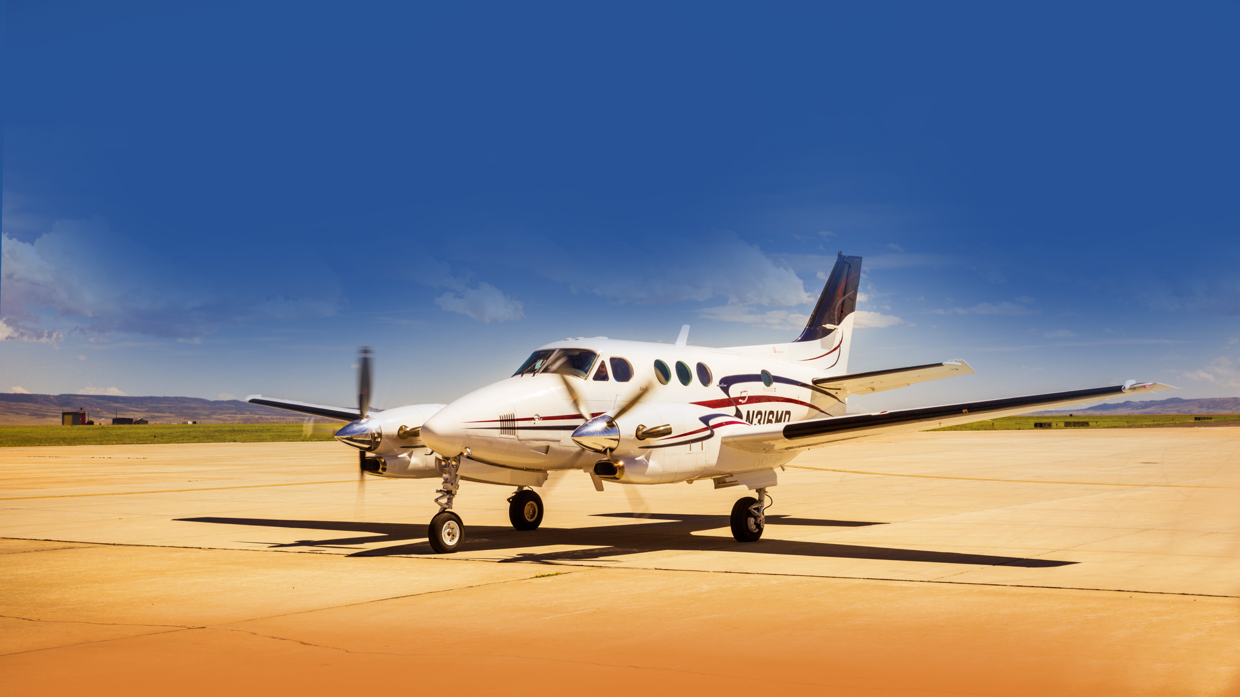
www.nbaa.org
Notes:
Slide 20: Summation
In short, in a host of ways, business aviation is essential in America, making possible all kinds of economic activity, community connections and lifesaving missions.
I hope you’ve been able to see a little bit of this industry today.

