Slide 1
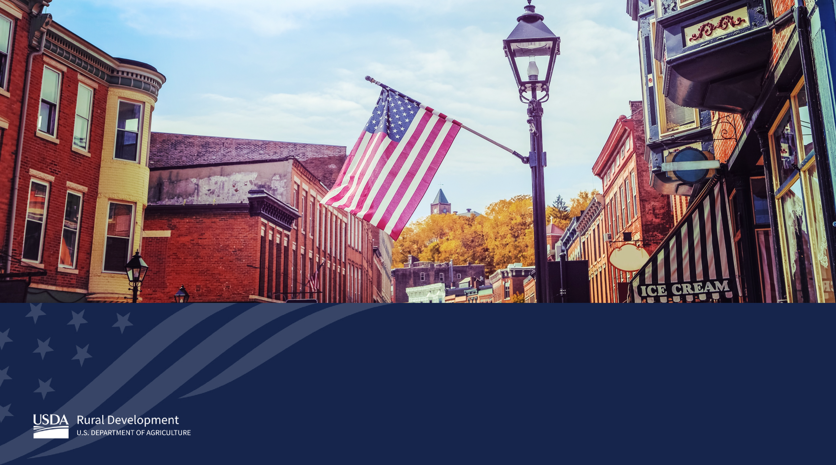
Community Facilities Programs
Anita Lopez, Asset Risk Coordinator, Western Region

Slide 2

Rural Development – Mission
Rural Development is a mission area within USDA that is the only Agency in the U.S. Federal government with the primary responsibility of serving rural America. Rural Development’s mission is to create economic prosperity and improve the quality of life in rural America.
Rural Development remains focused on helping rural communities build robust and sustainable economies. Rural Development programs can literally help build a community from the ground up by providing access to capital and funding for critical community infrastructure to attract new business, quality jobs and spur economic growth.

Slide 3
Rural Development Offices
Rural Development
Rural Business-Cooperative Service
Rural Housing Service
Rural Utilities Service
Notes:
At the national level, programs and services are delivered through three agencies.

Slide 4
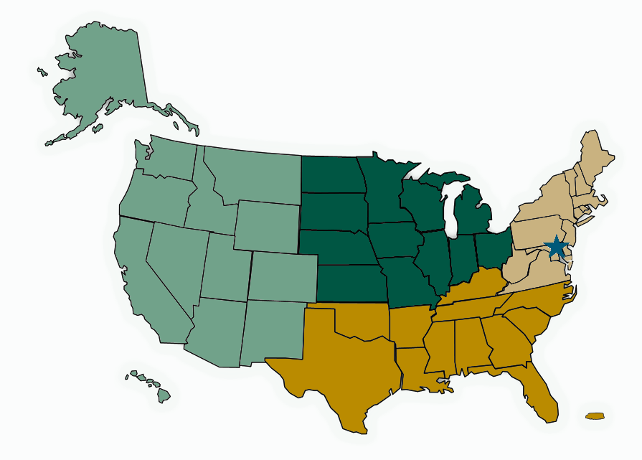
Rural Development Offices
4 Regions
47 State Offices
400 Area Offices
1 National Office in DC
Notes:
At the national level, programs and services are delivered through three agencies.

Slide 5
Rural Transportation Infrastructure – High Priority
America’s rural communities are an important linkage in the nation’s transportation network. Coast to coast, border to border, city to city, and farm to market, rural transportation systems connect our country. Most of the country’s food, fiber, manufactured goods – and even most of its energy – come from rural America. Therefore, investing in rural infrastructure, especially transportation infrastructure, is vital not just to the people that live there, but for every American and our overall national economy.
At USDA Rural Development we recognize that robust rural transportation infrastructure can help increase the competitiveness of rural communities to attract and retain businesses and industries that provide employment and services for their residents.
The Community Facilities Program, within Rural Development, can finance more than 100 different facility types, including rural transportation infrastructure such as, roads, bridges, airports, inland waterways, port and railroad related infrastructure, intermodal terminal facilities, and street improvements.

Slide 6

Community Facilities
Hospitals, health clinics
Schools
Daycares
Fire houses, first responder vehicles and equipment
Community centers and more.
Notes:
Loans, grants and loan guarantees for essential community facilities in rural areas. We give a priority to health care, education and public safety projects.

Slide 7
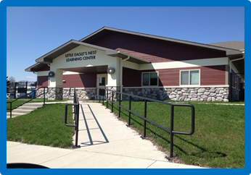
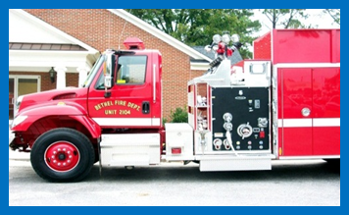
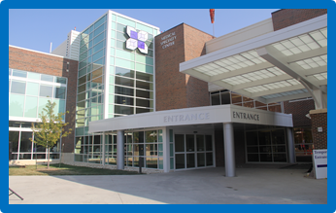
Community Facilities Programs Overview
Direct loans, loan guarantees and grants to develop or improve essential public services and facilities in communities of <20,000 for Direct loans and <50,000 for Guaranteed loans.
Eligible Applicants: Public Bodies, Non Profits, Indian Tribes
Eligible Purposes:
Construct, expand, renovate, or improve facilities
Purchase vehicles and major equipment
Refinance debt when <50% of total project costs
Associated project expenses

Slide 8
Community Facilities Programs Overview
  CF Direct Loan Rates and Terms
  Interest rates currently at 2.375% (Interest rates changed quarterly)
  40 year term or useful life
  Adequate security to protect the interest of the Govt
  Repayment ability/feasibility
  Unable to obtain other commercial credit

Slide 9
Community Facilities Programs Overview
  CF Guarantee Rates, Terms, and Fees
  Interest rate set by lender (fixed or variable)
  Term set by lender (max 40 year term or useful life)
  Adequate security to protect the interest of the Government
  Repayment ability/feasibility
  Lender must be unable to make loan without guarantee
  Up to a 90% guarantee on loss
  Up front fee of 1.50% fee payable upon issuance of Loan Note Guarantee, and 0.50% annual renewal fee

Slide 10
Community Facilities Programs Overview
  Application Process/Timeline
  Preapplication: Eligibility – Applicant, purpose, rural area, other credit
  Application: Feasibility, Environmental, Architectural Report
    Financial Feasibility Report
    Environmental – Consult on the applicable level of review early
    Preliminary Architectural Report – Cost Estimates, etc.
    Security Package: Appraisal
  BEST PRACTICES:
    Planning – start early – develop a project team, strategic plan/timeline, etc.
    Consult with your Rural Development State Office at concept/as early on as possible. Staff are very willing to guide and assist you through the entire process and structuring the request.

Slide 11
Community Facilities Program FY 20 Appropriations
RCDI: $6.5 Million
Tribal College Grants: $5 Million
TAT Grants: $1.5 Million
Strategic Economic Community Development (SECD) 10% set aside
Persistent Poverty areas 10% set aside
Community Facilities Direct Loans:
$2.8 Billion
Community Facility Guaranteed Loans:
$500 Million ($175 Million can fund
projects exceeding 20,000 population NTE 50,000)
Community Facility Regular Grants:
$30 Million
Notes:
SECD (Strategic Economic Community Development)
In FY20, there will be SECD reservations as follow:
•SECD Direct Loan - (10% of your state annual direct loan allocation)
•SECD Guaranteed Loan - (10% of your state annual guaranteed loan allocation

Slide 12

Community Facilities Program Investments

Slide 13
Community Facilities Success Story
Improving economic opportunities through airport expansion
CF assisted the expansion of Lamoni airport in Iowa by providing more than $750,000 in loan funds to support the extension of a runway and the construction of a six-bay hangar. Rural development’s investments were used as the community’s local matching funds with other partners including the Iowa Department of Transportation and the Federal Aviation Administration. A quote from a City of Lamoni council member, “A mile of highway will take you a mile, a mile of runway will take you anywhere,” underscores the importance of airport investments to the growth of the regional economy. Access to a commercial-size airport opens the entire region to new opportunities. The Community Facilities program can play a critical role in financing rural airports and airport expansions.

Slide 14
Community Facilities Programs
Rural Transportation
Infrastructure: Information and Guidance
Together, America Prospers
Community Facilities Programs Support Transportation Infrastructure
America’s rural communities are an important link in the nation’s transportation network. Coast-to-coast, border-to-border, city-to-city, and farm-to-market, rural transportation systems connect our country.
USDA Rural Development’s flexible Community Facilities Programs can help bring needed resources and innovation to create a framework for rebuilding transportation infrastructure in rural America. This resource provides information on how the Community Facilities Program can support rural transportation infrastructure.
https://www.rd.usda.gov/programs-services/all-programs/community-facilities-programs

Slide 15
Community Facilities
Direct Loan Program
Guidance Book for Applicants
Together, America Prospers
Community Facilities Direct Loan Program Guidance Book for Applicants
Community Facilities Direct Loan Program Guidance Book for Applicants is a step by step guide to help applicants apply for a Community Facilities Direct loan.
This guide book outlines the application process, financial feasibility requirements, construction and closing of an essential community facility for small towns and rural areas.
https://www.rd.usda.gov/programs-services/all-programs/community-facilities-programs

Slide 16
