Slide 1
Fargo Main Avenue
WGA * October 1, 2019

Slide 2
Project Area
Main Avenue – University Drive to 2nd Street
Full reconstruction within the right of way

Slide 3
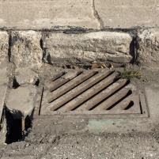
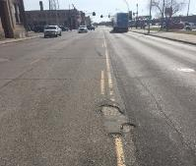
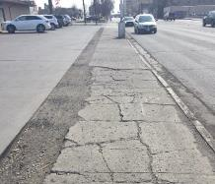
Need For Project
Aging Infrastructure
Pavement, sewer, water, storm sewer
Non-compliant ADA sidewalk system
Narrow sidewalks directly adjacent to travel lanes
Limited on-street parking along corridor
The corridor is lined with a number of undeveloped and under-utilized properties

Slide 4
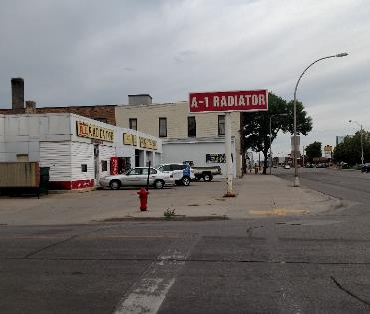
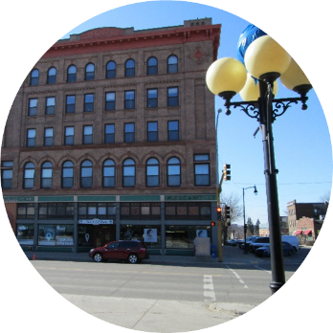
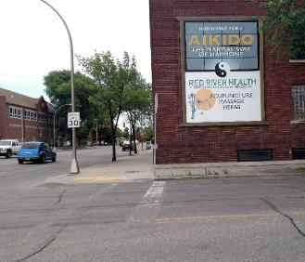
Purpose Of Project
Pedestrians: Create an active & comfortable environment
Vehicles: Support traffic needs
City-wide: Contribute to an environment that encourages business activity, investment and redevelopment throughout a reinvented corridor, fully integrated into the urban fabric of downtown
Corridor Improvements: Address safety issues, improve capacity constraints, provide safe and efficient regional corridor

Slide 5
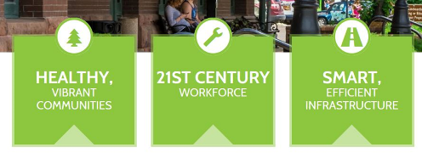
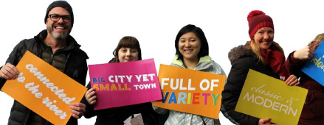
Revisiting purpose of project
Main Street Initiative
Public Input Meeting – April 27, 2017
Continued Stakeholder and Public Input
Further Studies Completed of Corridor
Redevelopment and Economic Analysis
Change in Purpose Statement
Reduced Lane Considerations
Downtown InFocus Plan
2016-2018

Slide 6
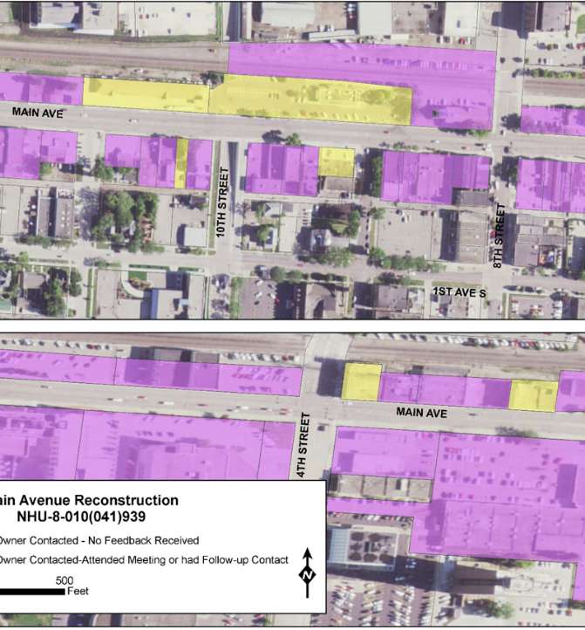
Property and Business Owner Engagement
Three days at the Fargo Park District Depot
Approximately 60+ business/property owner representatives
Opportunity for owners and businesses to provide detailed property information and input
Multiple follow-up meetings and discussions

Slide 7
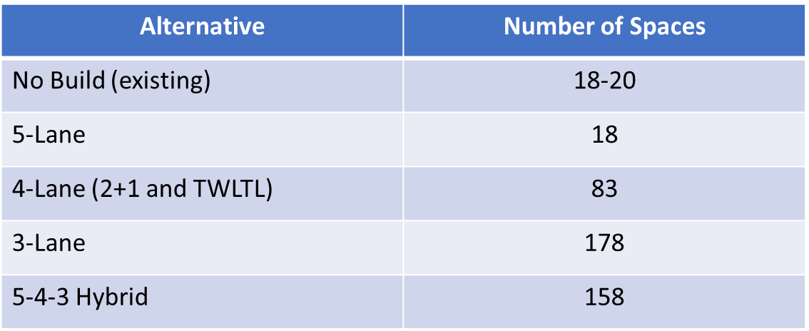
Reduced Lanes
Control of Traffic Speeds
Pedestrian Environment
Potential for Redevelopment and improved economics
On-Street Parking

Slide 8
Redevelopment & Economic Analysis
5-Lane Scenario
3-Lane Scenario

Slide 9
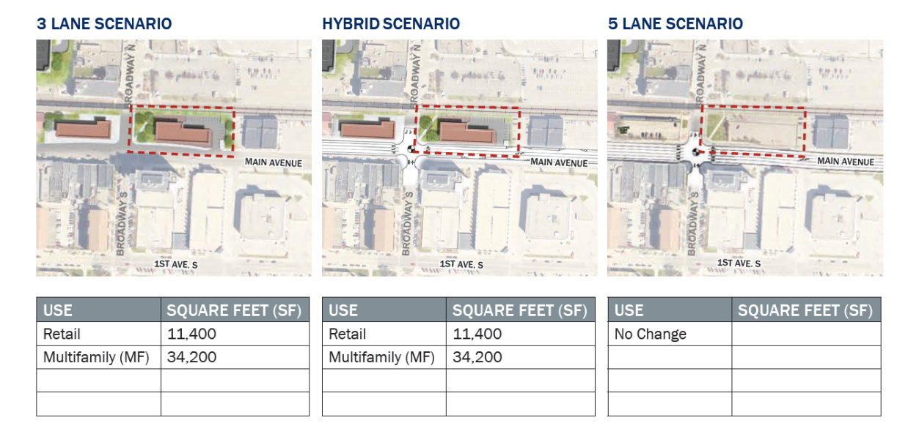

Slide 10
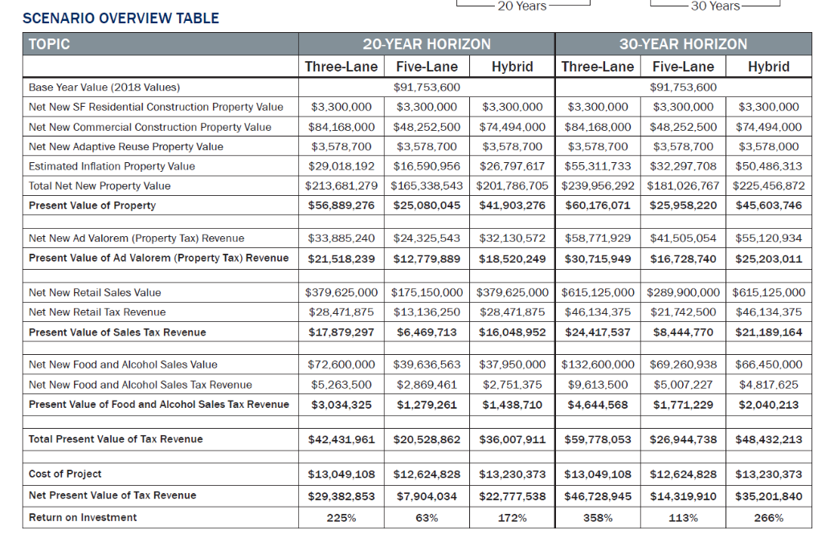

Slide 11
Project goals and priorities
Relating the Purpose and Need
Roadway Characteristic | What does that mean? | No Build | 5-Lane | 4-Lane | 3-Lane | 5-4-3 Hybrid
Vehicular Mobility | Speed, Level of Congestion
Pedestrian Environment | Walkability, Safety, Aesthetics
Placemaking and Economics | Infill, Redevelopment, Adaptive Reuse, Gateway & Community Aesthetics, Property Value
Optimal
Moderate
Poor

Slide 12
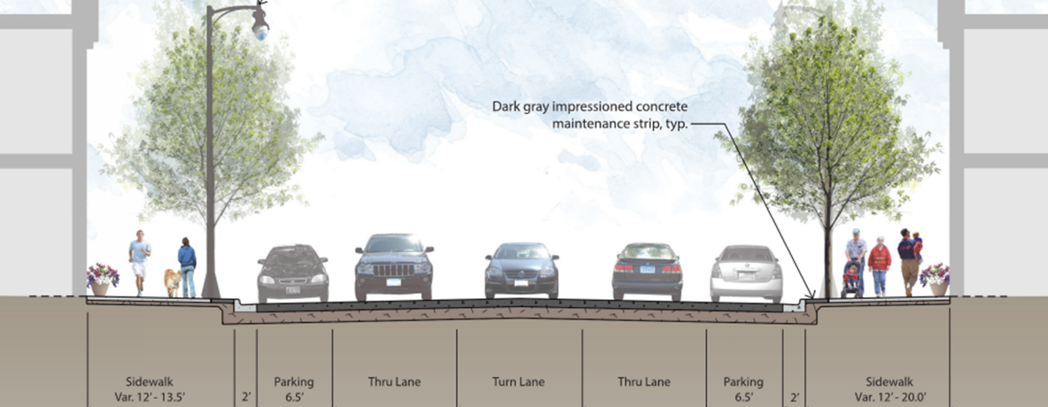
Project Decisions
5-4-3 Lane Hybrid Design
Environmental Document and Stakeholder Decision -August 2018 –5-4-3 Hybrid
Project Split – October 2019 Project Costs, Funding, Right of Way Acquisitions
Construction Phase 1 2019 – Broadway to Red River
Construction Phase 2 2020 – University Dr to Broadway
Notes:
Hybrid 5-4-3 Lane Section
On-street parallel parking throughout corridor
Improve sidewalk widths and ADA compliance
Potential system impacts as trips could be diverted to other corridors

Slide 13
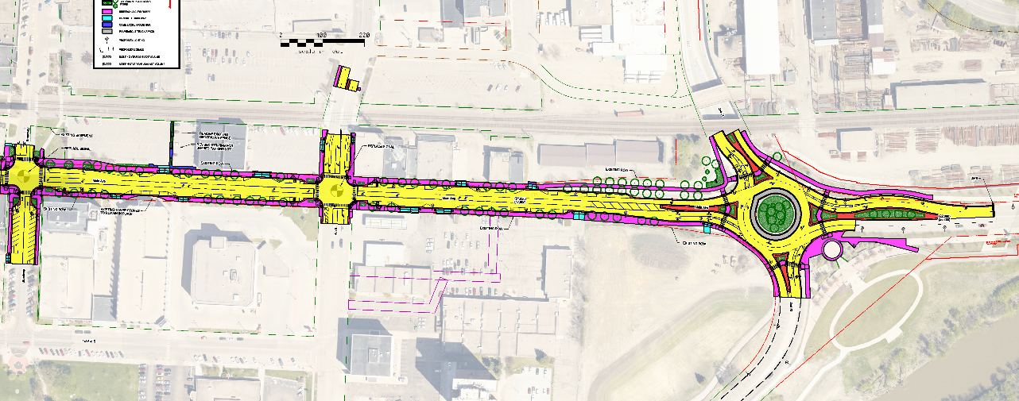
Final Improvement
Phase 1 - Broadway to Red River

Slide 14
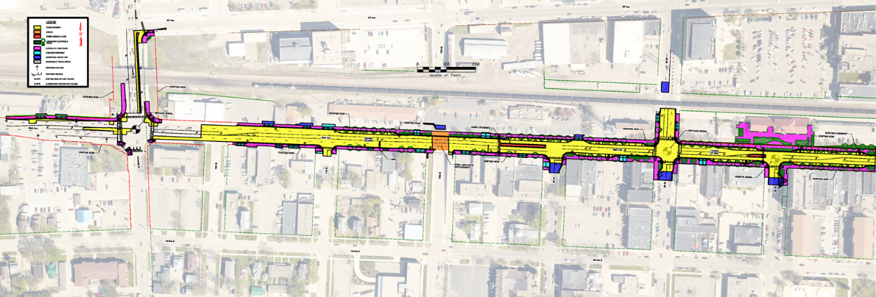
Final Improvement
Phase 2 – University Dr to Broadway

Slide 15
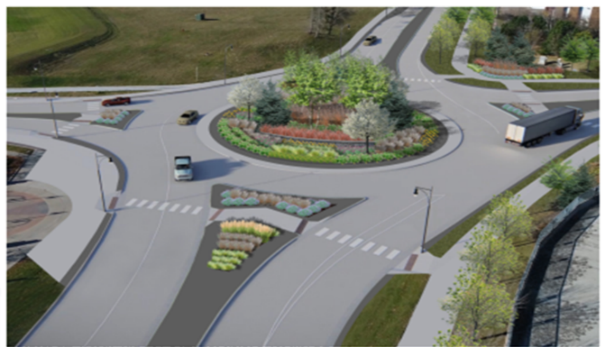
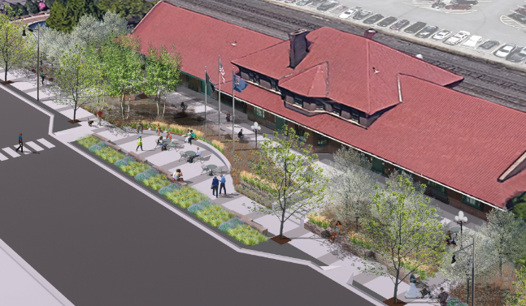

Slide 16
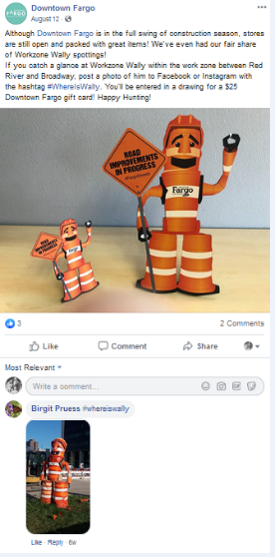
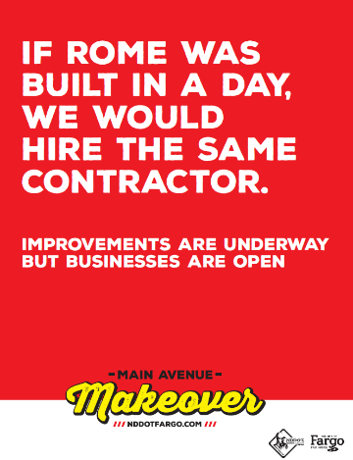
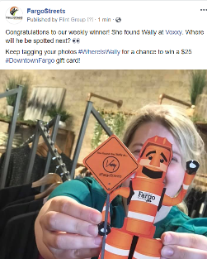
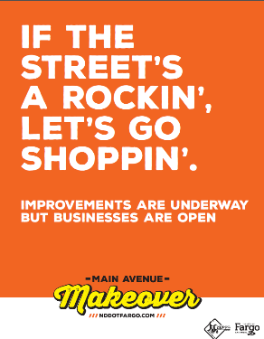
Community Engagement During Construction

Slide 17
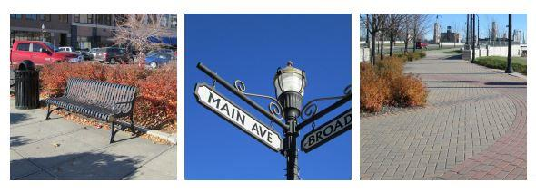
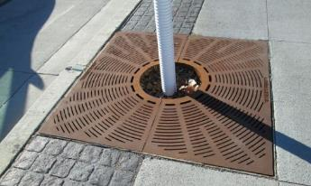
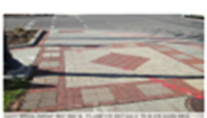

Slide 18
