Slide 1
Fiber & Fixed Wireless Connectivity for the Rural Midwest
Closing the Digital Divide

Slide 2
Midwestern Company
Over 90% of wired footprint has Gig access
10G initiative - $500 million investment over the next 10 years

Slide 3
Fixed Wireless Helps Connect Rural America

Slide 4
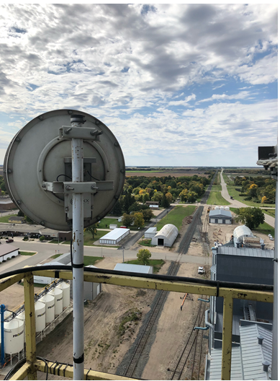
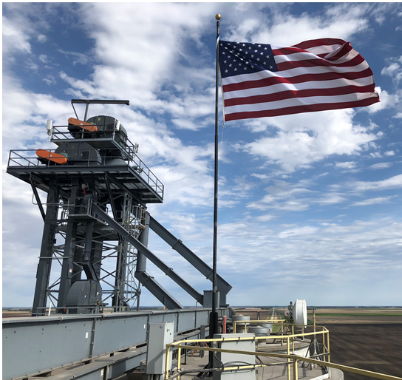
Fixed Wireless, vertical assets in rural America

Slide 5
Midco Edge OutSM to Serve Rural America

Slide 6
CAF Fixed Wireless Expansion
Notes:
20,000 subs; 3-6 yr buildout

Slide 7
Fixed Wireless Near Future
220/27+ Mbps field tested on LTE technology at a 7-mile radius
2 Gig symmetrical for businesses field tested at 3-mile radius
8,374 CAF locations total; 100,000+ new homes passed total
100/20+ speeds built out over 3-6 years

