Slide 1
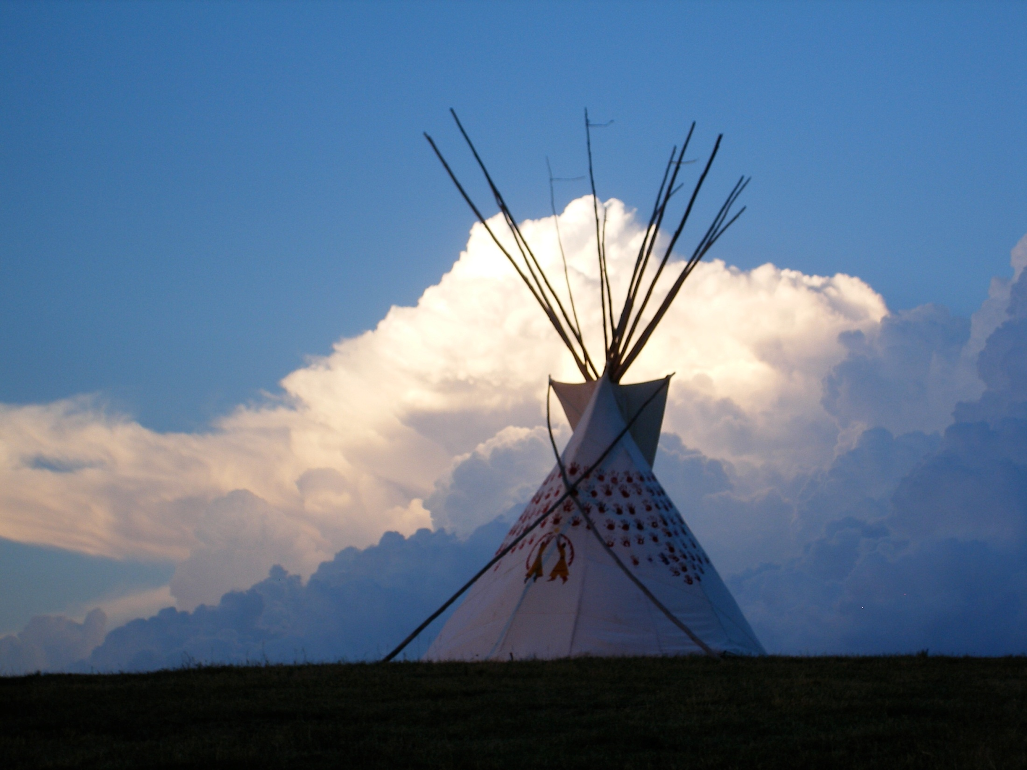
Thunder Valley Community Development Corporation

Slide 2
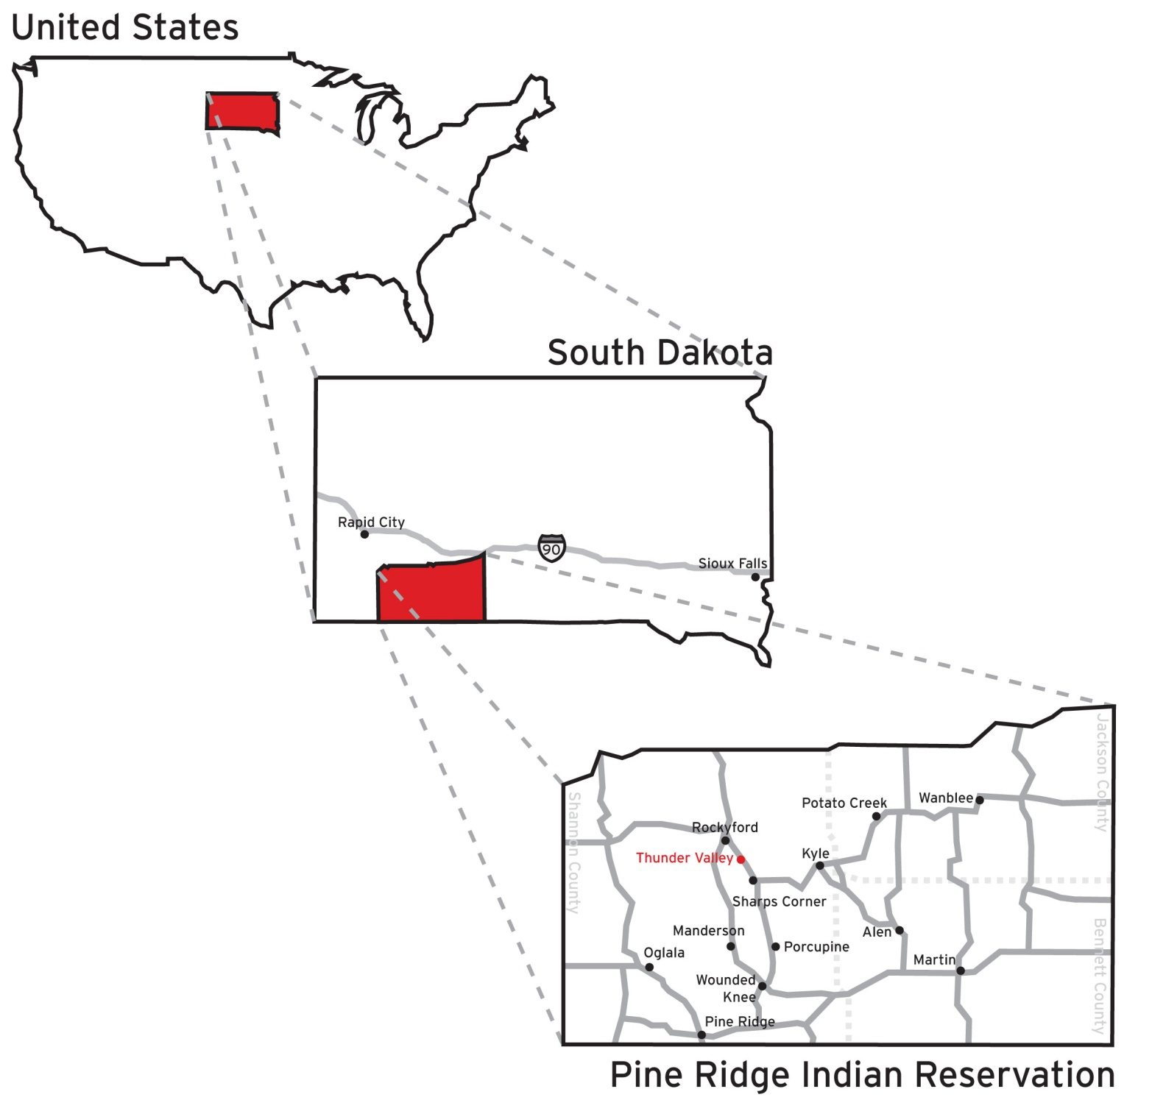
Oglala Lakota
“Scatters Their Own / First to Attack”
Nine Reservation Districts:
1. Eagle Nest
2. LaCreek
3. Medicine Root
4. Pass Creek
5. Pine Ridge
6. Porcupine
7. Wakpamni
8. White Clay
9. Wounded Knee
Tribal/Agency Headquarters: Pine Ridge, SD
Counties: Bennett, Jackson, Oglala Lakota
Languages: Lakota, English
Total Area: Approximately 2,700,000 acres
Tribally Owned: 706,340 acres
Allotted Owned: 1,064,840 acres
Total Tribal/Allotted Owned: 1,771,180 acres (65.5%)
Federal or Non-tribally Controlled: 928,820 acres (34.5%)
Notes:
On the Pine Ridge Indian Reservation, home of the Oglala Lakota Nation… Thunder Valley is in the Porcupine District between Sharps Corner and Rockyford and is home to a growing movement for lasting, healthy change amongst the people of this community.

Slide 3
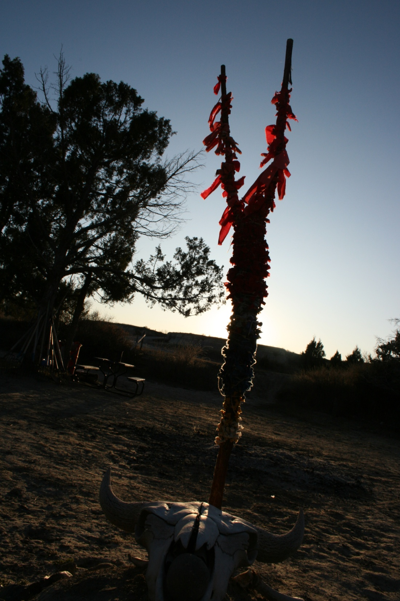
MISSION STATEMENT
“Empowering Lakota youth and families to improve the health, culture and environment of our communities through the healing and strengthening of cultural identity.”
Thunder Valley Community Development Corporation

Slide 5
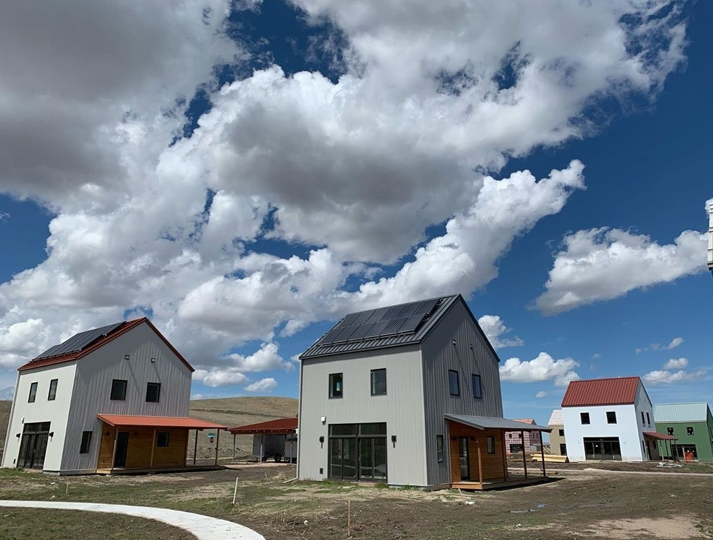

Slide 6
Jennifer Irving,
Deputy Director
(605) 455-2700
jennifer@thundervalley.org
www.ThunderValley.org

