Slide 1


Slide 2
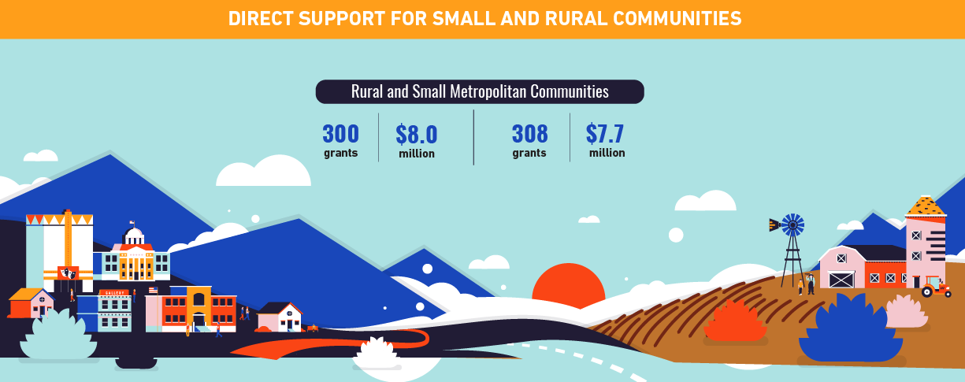
The Arts in Rural Communities
Rural Communities (2015)
300
$8
grants
million

Slide 3

Arts Endowment Funding
ARTS ENDOWMENT FUNDING
40%
To You

Slide 4
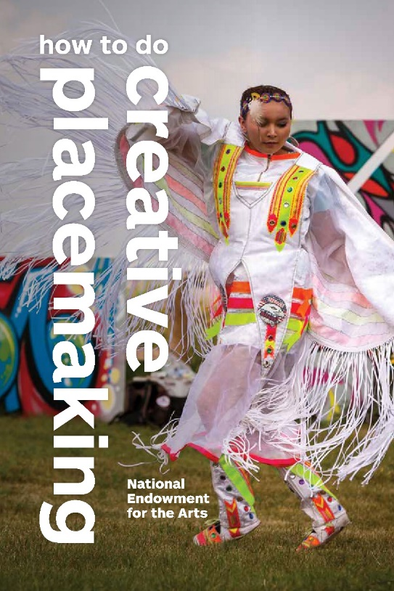
Our Town
Creative placemaking projects
Applicants must be partnerships between
  a nonprofit design or cultural organization
  a local government entity
Grants generally range from $25,000 to $200,000
Notes:
Our Town is the National Endowment for the Arts’ creative placemaking grant program. These grants support projects that integrate arts, culture, and design activities into efforts that strengthen communities by advancing local economic, physical, and/or social outcomes.
There are two types of funding available:
Place-based projects that contribute to quality of life in local communities through arts engagement, cultural planning, and design. These projects require a partnership between a local government and a nonprofit—one of the partners must be an arts/culture/design organization. Grants range from $25,000 to $200,000.
and
Projects that build and disperse knowledge about how to leverage arts, culture, and design as mechanisms for strengthening communities. These grants range from $25,000 to $100,000.
The deadline to apply is usually in August.

Slide 5
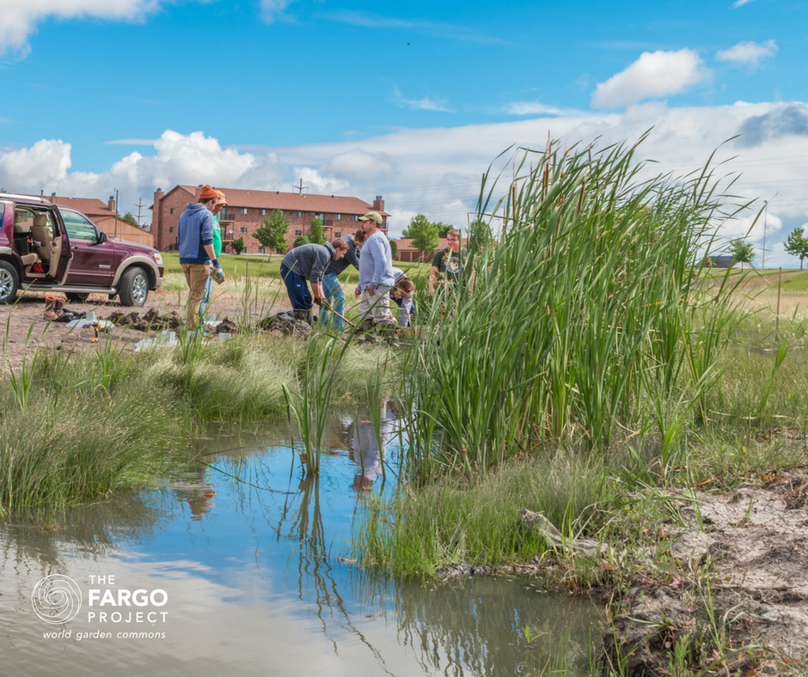
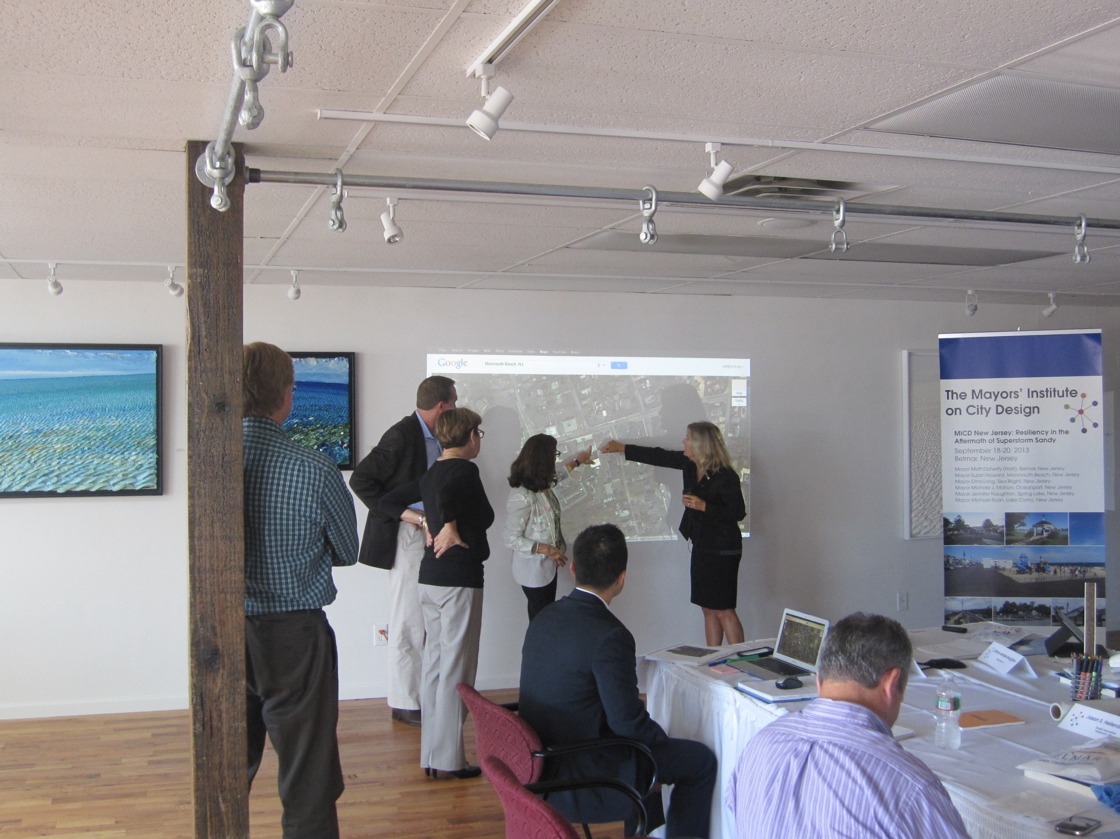
Mayor Institute on City Design (MICD)
A leadership initiative of the National Endowment for the Arts
in partnership with the U.S. Conference of Mayors
Notes:
Mayors’ Institute on City Design
Five or six times a year, convenes eight mayors and design experts in architecture, planning, landscape architecture, transportation, and economic development to solve the most critical planning and design challenges facing their cities.

Slide 6
The Citizens' Institute on Rural Design (CIRD)
Rural design utilizes design strategies to improve:
Community streets
Buildings
Public spaces
Landscapes
Communities <50,000
Notes:
A population of 50,000 people or less would qualify for CIRD. The term used to describe the community is Rural in Character.
The Citizens' Institute on Rural Design (CIRD) connects communities to the design resources they need to convert their own good ideas into reality.
CIRD is a leadership initiative of the National Endowment for the Arts (NEA) conducted in partnership with Project for Public Spaces, along with the Orton Family Foundation. Simply stated, rural design utilizes design strategies – improvements to a community’s streets, buildings, public spaces, or landscapes – to address the specific physical, environmental, social, and economic challenges facing rural areas.
CIRD was founded by NEA to help connect local leaders and residents of smaller communities in rural areas to the resources, evidence-based knowledge, and design expertise they need to make the best choices going forward. Since 1991, CIRD has convened more than 75 workshops in all regions of the country, empowering residents to leverage local assets today in order to build better places to live, work, and play in the future. Using design as a core strategy, CIRD helps rural communities celebrate and enhance their existing local resources.

Slide 7
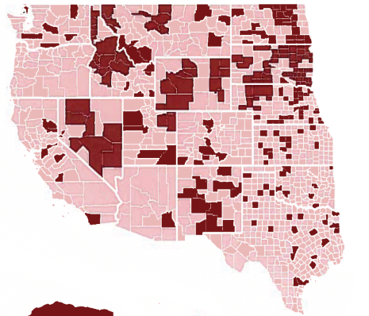

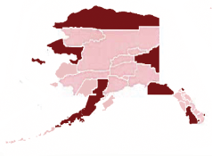

Endowment vs. Private Funding in Counties
Counties not funded by the top
1,000 private/community foundations

