Slide 1
Rewriting the Rural Narrative Speak softly and carry statistics
Benjamin Winchester
Senior Research Fellow
Extension Center for Community Vitality

Slide 2
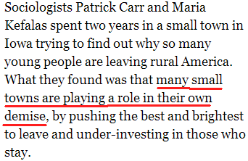

Slide 3
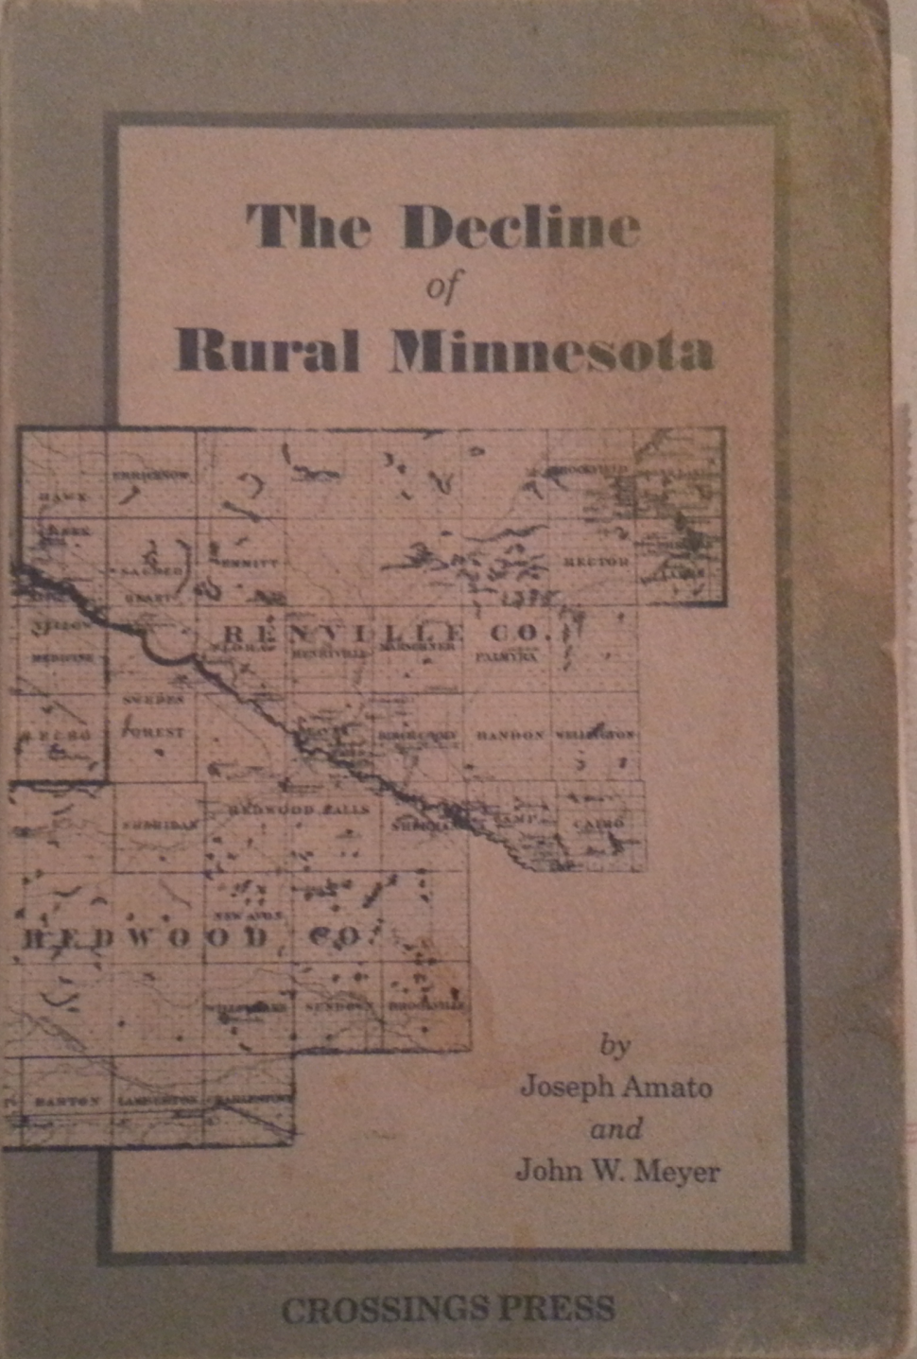
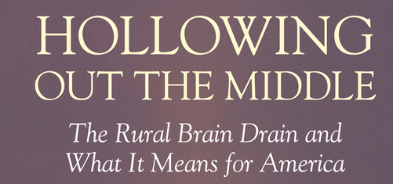

Slide 4
The narrative
There’s a brain drain
We live in the middle of nowhere
We are a sleepy town
Everyone knows one another
Nobody lock their doors
What we had
What we don’t have
What we wish we had
What we could have had…

Slide 5
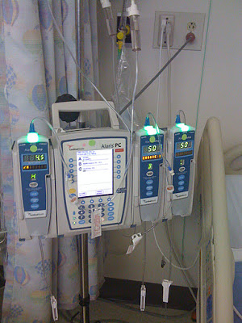
Deficit Approach Fixing things that can’t or shouldn’t be fixed

Slide 6
No More Anecdata!
anecdata (noun). information which is presented as if it is based on serious research but is in fact based on what someone thinks is true

Slide 7
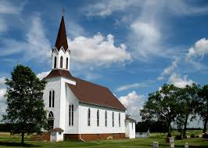
1900-1950
Mechanization of agriculture
Roads and transportation
Educational achievement and population loss
Church closings (Delafield)

Slide 8
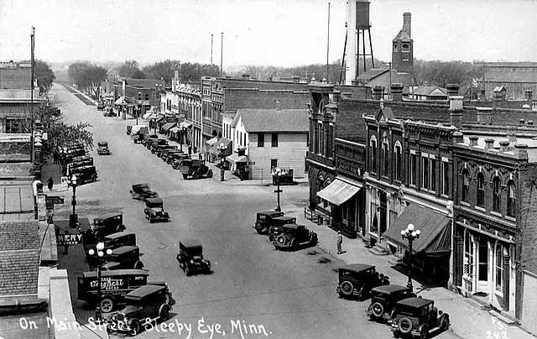
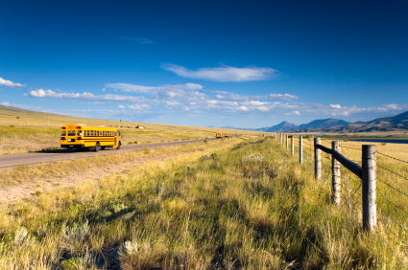
1950+
Main street restructuring
School consolidations
Hospitals closings

Slide 9
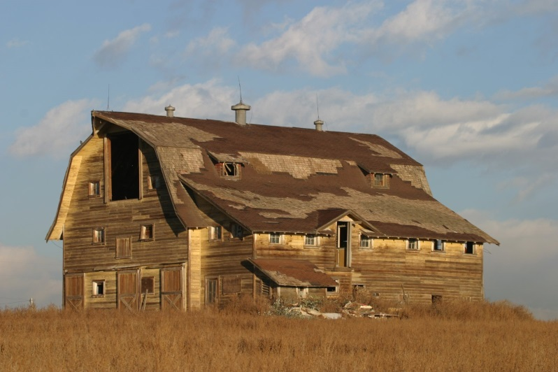
The rural idyll
Notes:
We aren’t close knit. We don’t all know each other.

Slide 10
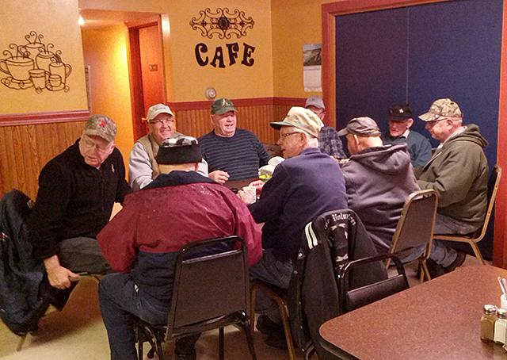
The Media Idyll Persists
Who are you going to find in a small town when you travel to small towns in morning and afternoon?
http://www.dailyyonder.com/speak-your-piece-just-say-no-to-poverty-porn/2016/12/02/16407/
Photo by Denise Peterson
Notes:
We aren’t close knit. We don’t all know each other.

Slide 11
Rural is Changing, not Dying
Yes, things are changing
Small towns are microcosms of globalization
Many of these changes impact rural and urban areas alike (not distinctly rural)
Yet more apparent in rural places
Survived massive restructuring of social and economic life
Research base does NOT support notion that if XXXX closes, the town dies
In Minnesota only 3 towns have dissolved in past 50 years

Slide 12
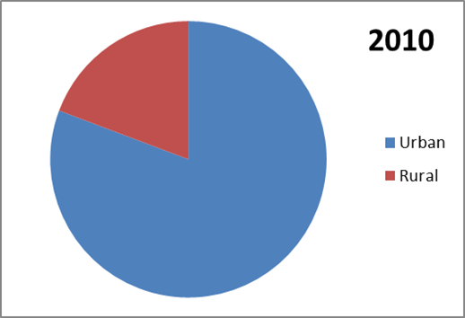
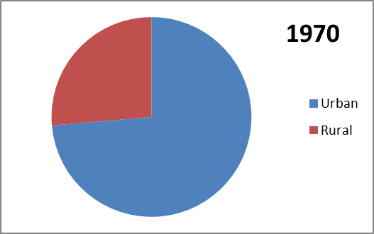
Rural Rebound
Since 1970, rural population increased by 11%
Relative percentage living rural decreased
19%
26%
203,211,926
(53.6m rural)
308,745,538
(59.5m rural)

Slide 13
Rural Data
Population figures reduced by formerly rural places now designated as urban (since 1974)
Iowa 473,312
Minnesota 352,224 rural residents now classified urban
Montana 120,261
Nebraska 170,855
North Dakota 181,639
South Dakota 207,790
Urban areas have grown WIDER, not TALLER

Slide 14
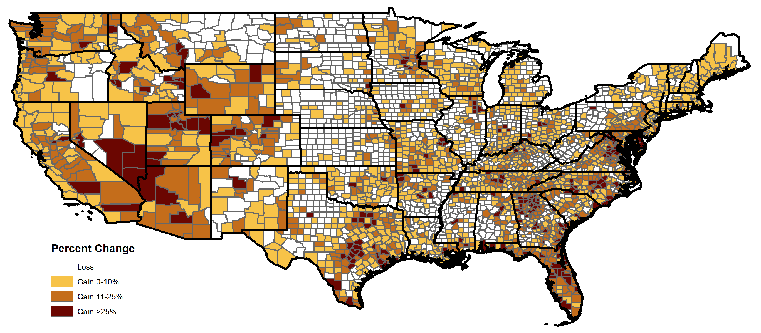
Total Population Infatuation 2000-2010

Slide 15
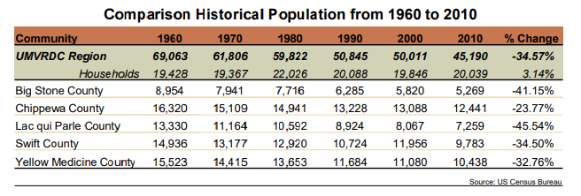
Total Population Infatuation
Wait, what?

Slide 16
Kids graduate
Population: -2
Households: NC
Spouse passes
Population: -1
Households: NC
Avg HH Size:
1940: 3.6
2018: 2.6 (-29%)

Slide 17
 | Pop Change | Occ HU Change
Carter | -15% | -2%
Dawson | -1% | 3%
Garfield | -6% | 0%
Judith Basin | -11% | -3%
Phillips | -8% | -2%
Richland | 1% | 7%
Rosebud | -2% | 3%
Silver Bow | -1% | 3%
Wheatland | 4% | 4%
2000-2010 U.S. Census Bureau

Slide 18
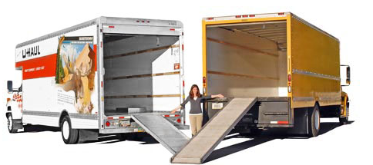
Mobility
Households moving every 5 years:
44% Iowa
46% Minnesota
North Dakota
47% Nebraska
48% South Dakota
49% Montana
49% United States
Notes:
38% Pennsylvania
46% Minnesota
49% United States
51% Wyoming
53% Idaho
54% Utah (9th highest rate)
67% Nevada
50% Kansas
55% Texas

Slide 19
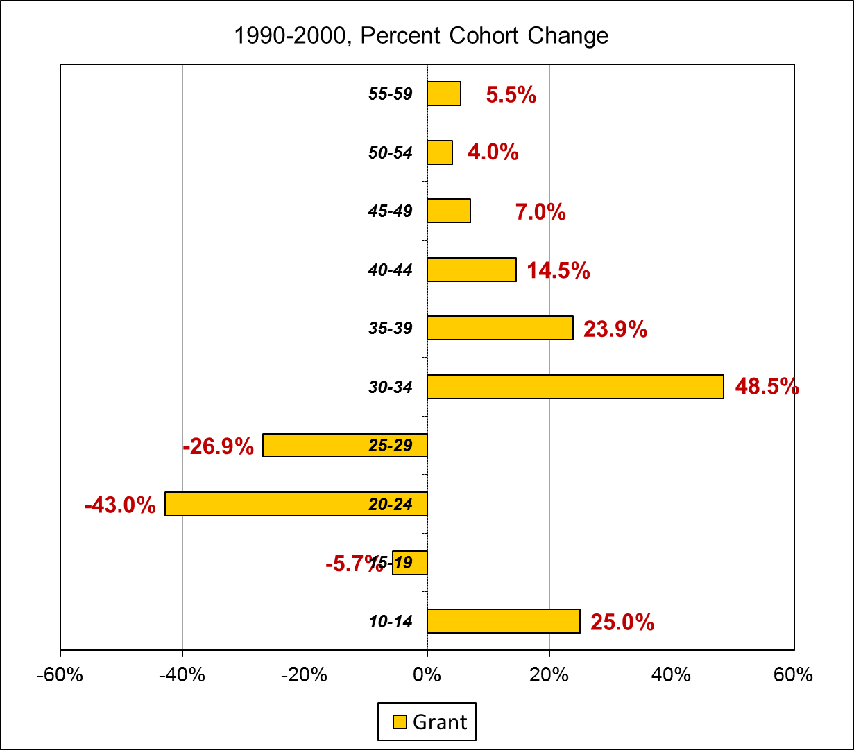
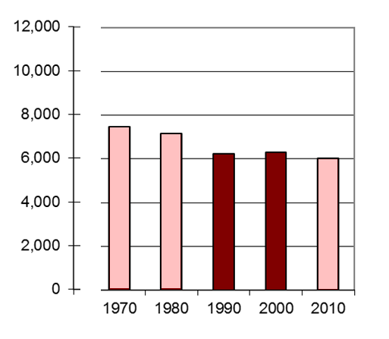

Slide 20
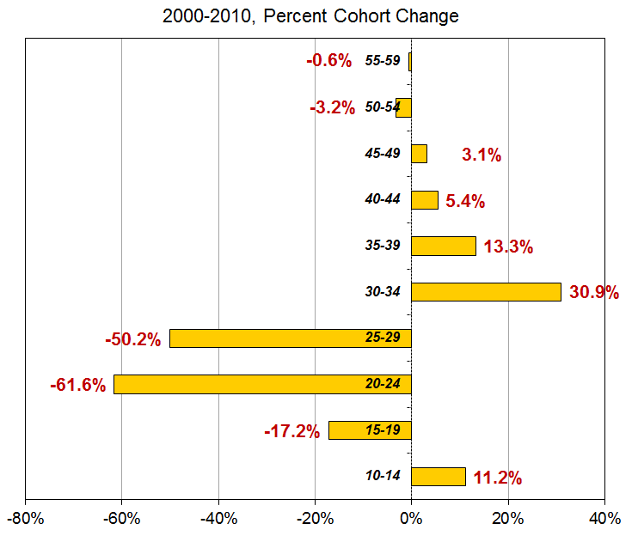
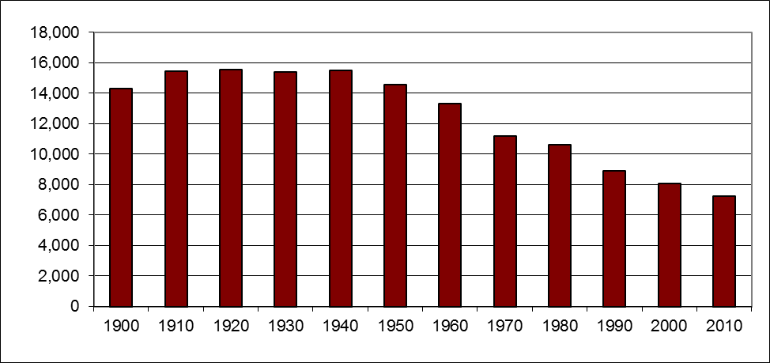
Rural Prairie County

Slide 21
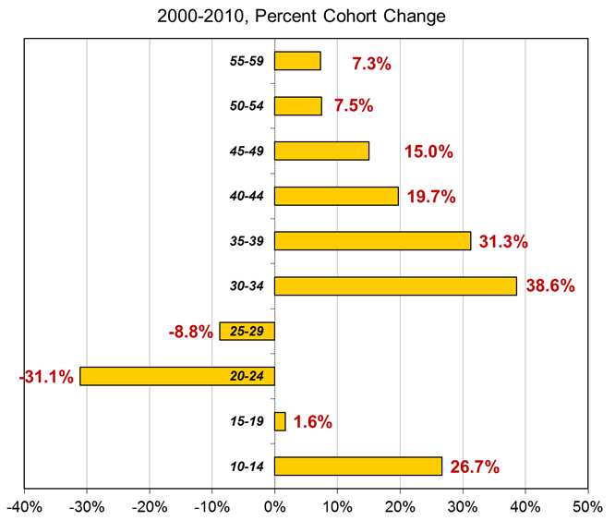
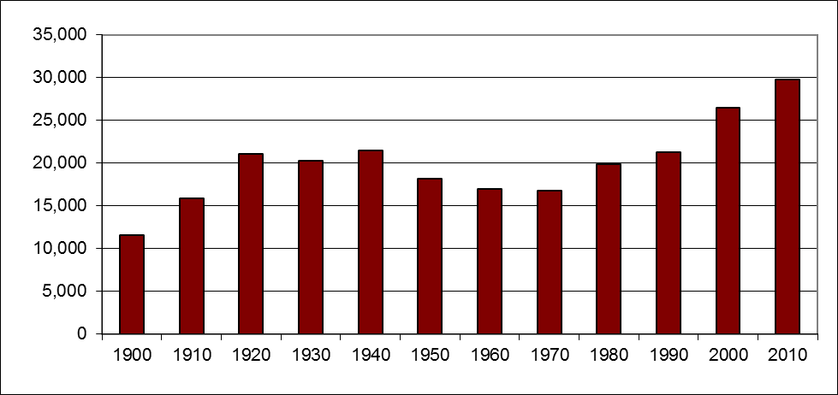
Rural Recreational County

Slide 22
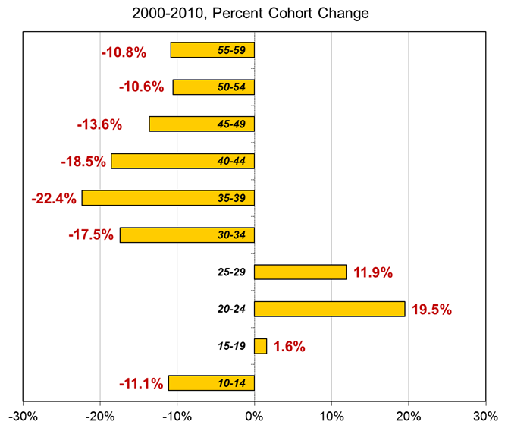
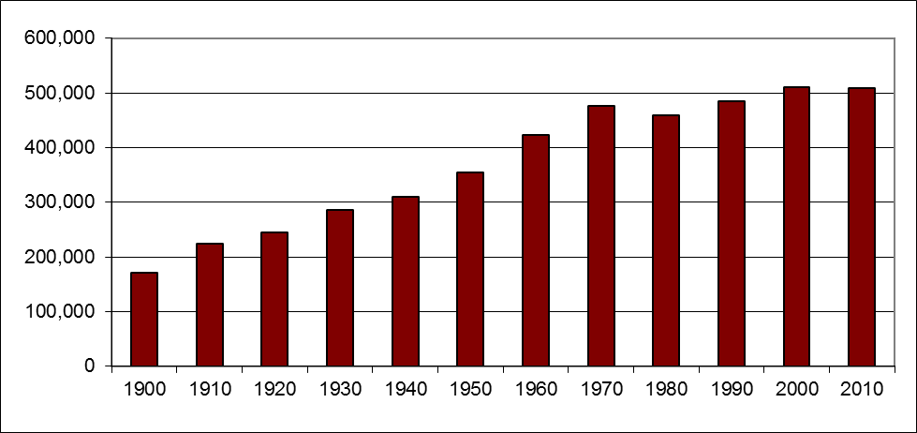
Core Metropolitan County

Slide 23
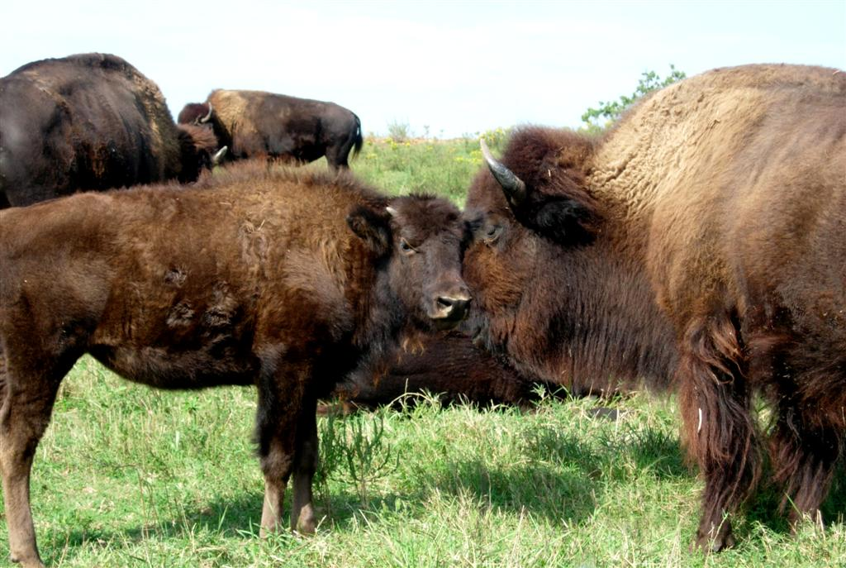
Buffalo Commons Research
Dr. Randy Cantrell and Cheryl Burkhart-Kriesel
University of Nebraska

Slide 24
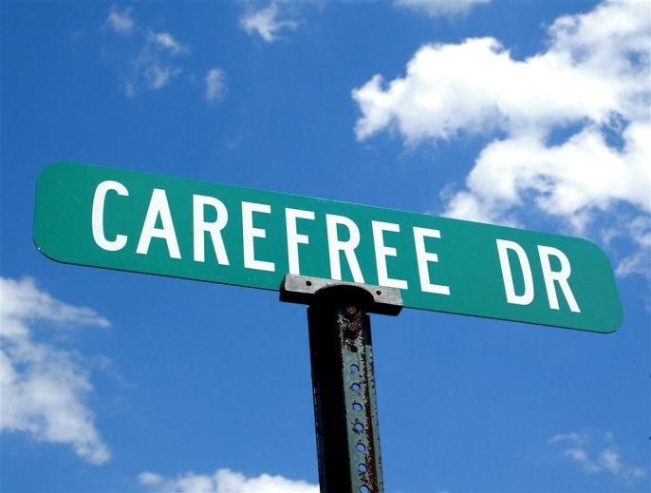
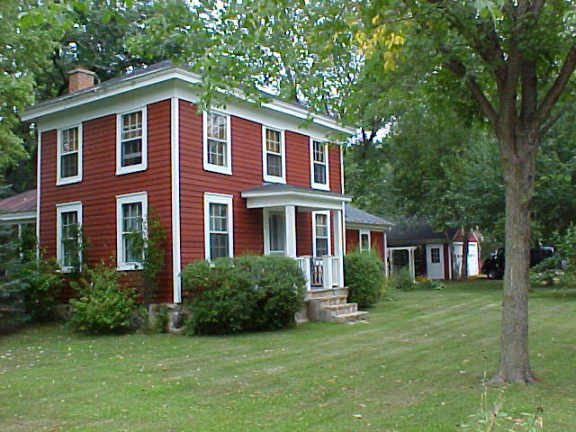
Newcomers: Why?
Simpler pace of life
Safety and Security
Low Housing Cost
Notes:
Simpler pace of life
Safety (children riding their bicycles)
Low housing costs

Slide 25
Newcomers: Who?
36% lived there previously
68% attain bachelors degree
67% household incomes over $50k
51% have children in household
May be leaving their career or underemployed
Yet, Quality of Life is the trump card

Slide 26
Middle of Everywhere
How can we make local decisions while at the same time respect the reality of lives?
The REGION is the primary unit of interest
Mayor, how do you market your town if you don’t know what’s going on around you?

Slide 27
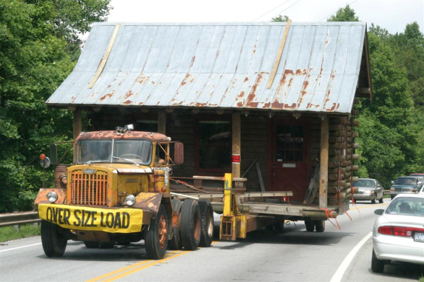
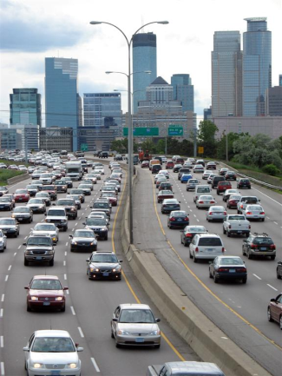
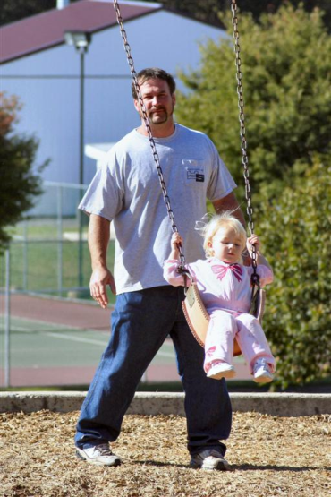
Cohort Lifecycle
Avg. American moves 11.7 times in lifetime
(6 times at age 30)

Slide 28
Choosing Rural
Brain Gain: migration to rural age 30-49
Also 50-64 but not as widespread
Brain drain is the rule, not the exception
Happening since the 1970s
Newcomers look at 3-5 communities
Topical reasoning (local foods regions)
Assets vary by demographic
Employee recruitment must get past “warm body” syndrome

Slide 29
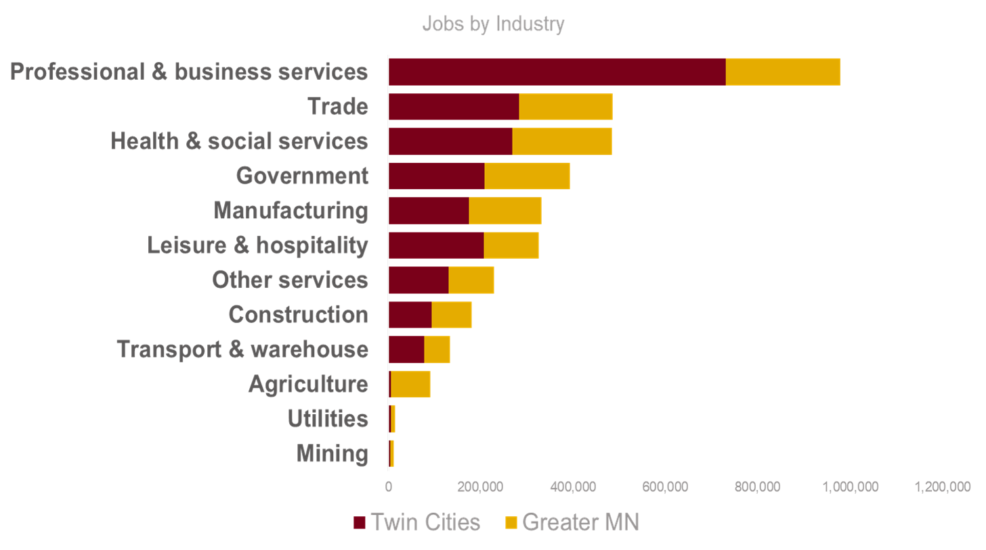
Diversifying the rural economy

Slide 30
Rewriting the Rural Narrative: The Demand for Leadership in Rural America

Slide 31
Social life is dYING!
First question: How many people do we need to run our town?
We have numerous leadership programs currently training leader supply, but are we keeping up with the organization demand?

Slide 32
DEMAND TRENDS

Slide 33
Leadership Demand
How do we measure the demand that organizations make upon the resident population?
In the US, there are 90,052 governmental units
In Minnesota, there are 3,672 governmental units – about one for every 1,500 persons.
These government units include counties, cities, townships, school districts, and “special districts” such as those providing oversight for cemeteries, highways, water/sewer systems, and soil/water conservation areas.
We also have a vibrant nonprofit sector…
U.S. Census Bureau, 2007 Government Integrated Directory.

Slide 34
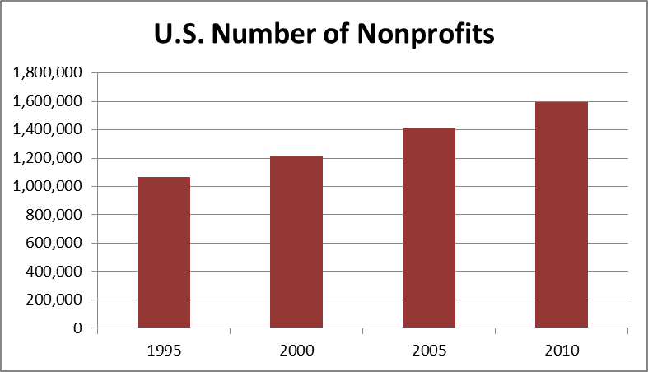
Social Life is Not Dying Nonprofit Growth: 1995-2010
1995-2000 13.6%
2000-2005 16.3%
2005-2010 13.1%
National Center for Charitable Statistics, U.S. Census Bureau

Slide 35
Social Life is Not Dying Nonprofit Growth: 2000-2010
The U.S. gained 10% in population and gained 32% in the number of nonprofits.
- The most rural counties experienced a loss of 1% in population, yet the number of nonprofits increased 15%.
This growth can be both good and bad news for rural places.
National Center for Charitable Statistics, U.S. Census Bureau

Slide 36
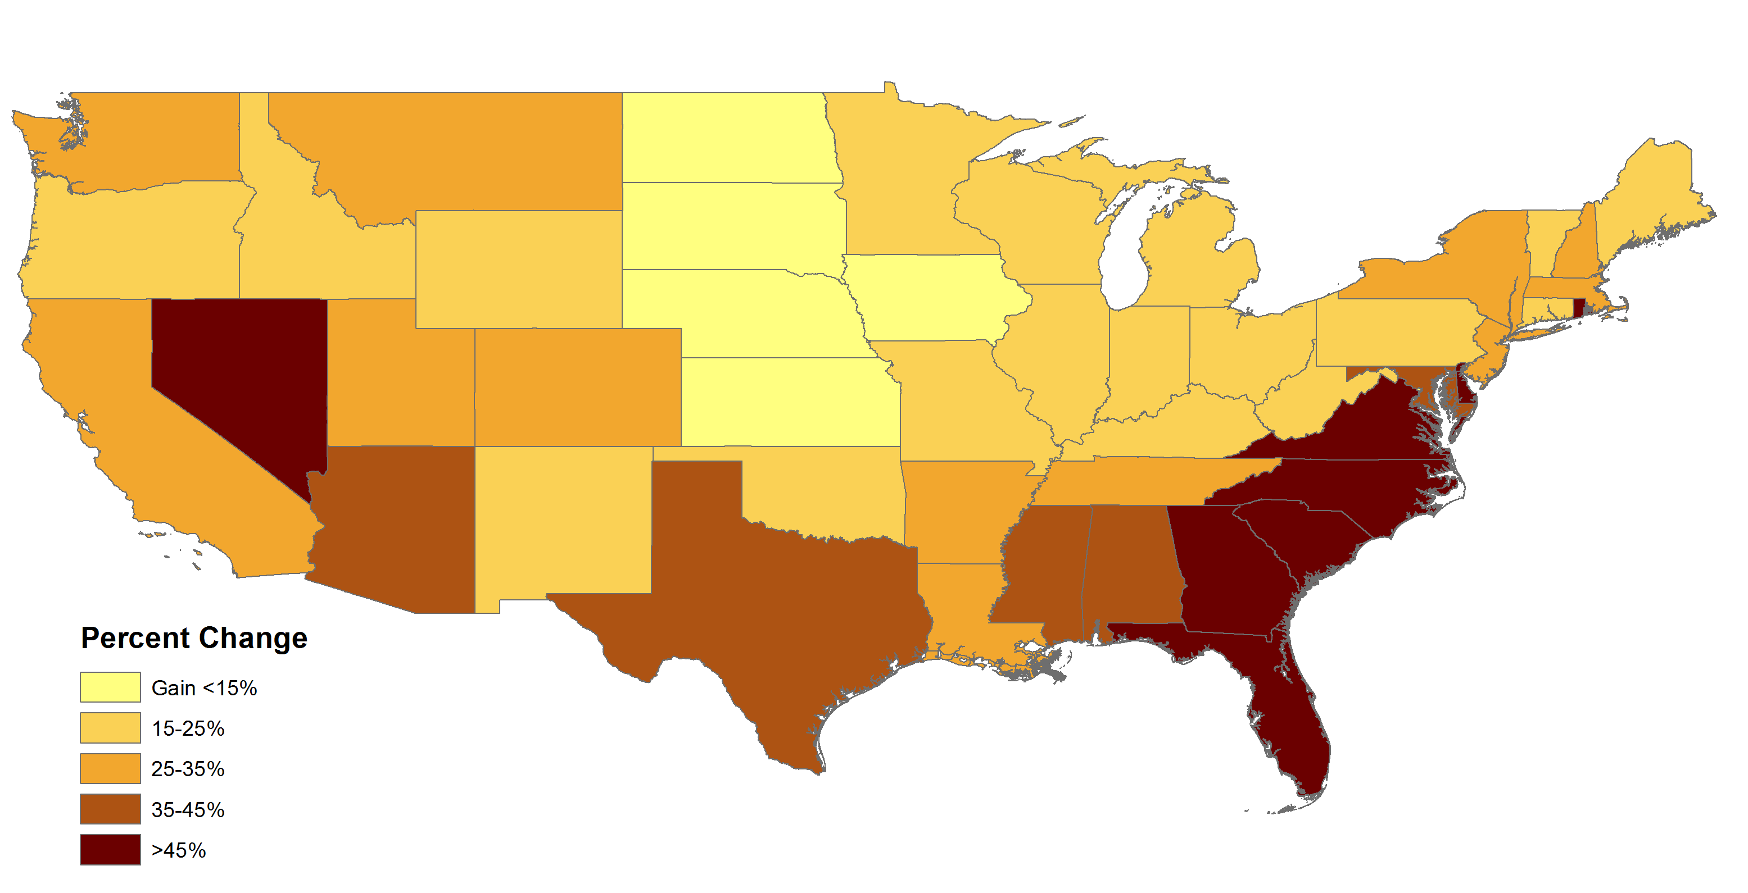
Nonprofit Change: 2000-2010

Slide 37
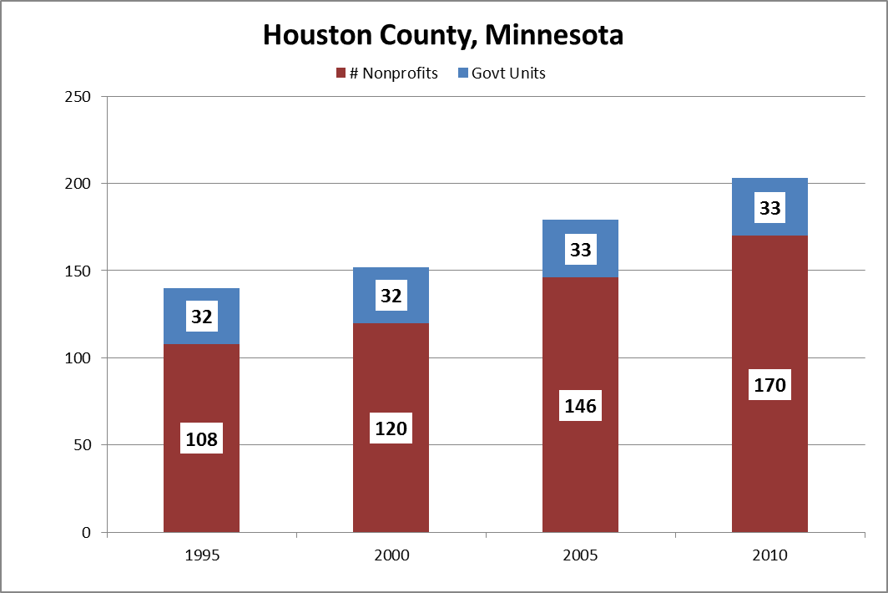
There are also gains and losses between these time periods, losses (or gains) don’t mean just losses (or gains).

Slide 38
SUPPLY TRENDS

Slide 39
Social Organizations
Diversification of rural life socially, too
Reflect the social interests at any given time
Today is not 25 (or 50, or 100) years ago!
The people today seem unable to “connect” with the existing social infrastructure

Slide 40
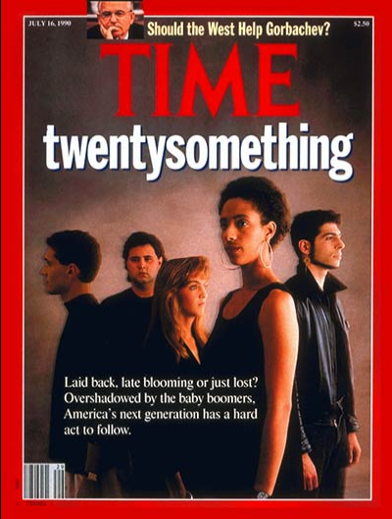
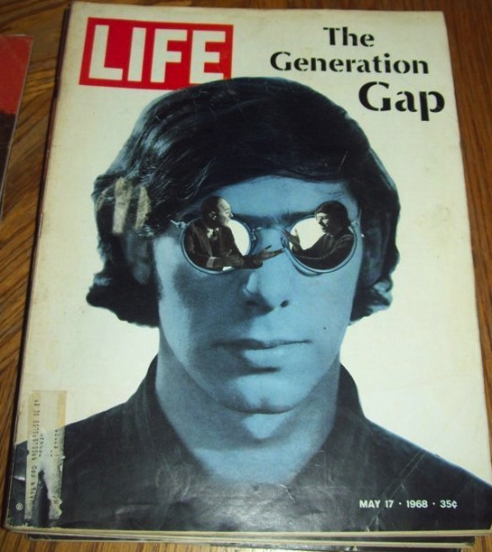
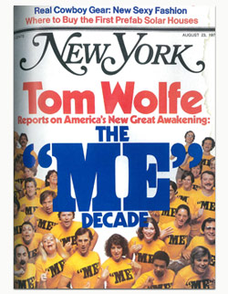
All of this has happened before…
1968
1976
1990

Slide 41
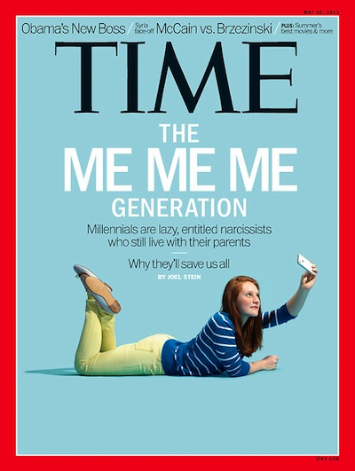
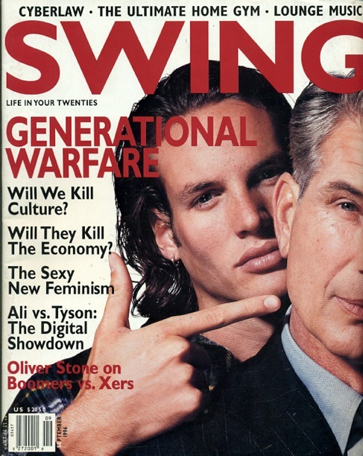
and it will happen again…
1996
2007
2013

Slide 42
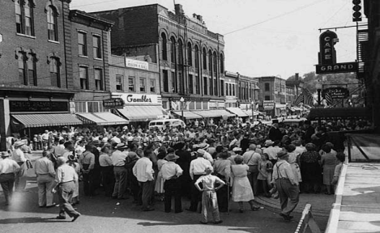
Changing Types of Involvement - The Social Organization (historical)
Place-based
Broadly focused
Word of mouth
Green & Haines. 2007. Asset Building and Community Development
Notes:
NARROW geography, WIDE focus == Hancock Community Betterment Club
42

Slide 43
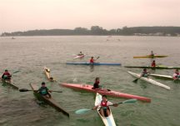
Changing Types of Involvement - The Social Organization (present)
Cover wide geographic area
Narrowly focused goals/
self-interest
Diverse social interests
Technological – social media
The people today are challenged in “connecting” with the existing social infrastructure.
Green & Haines. 2007. Asset Building and Community Development
Notes:
NARROW geography, WIDE focus = West Central MN Snowmobile Assn
43

Slide 44
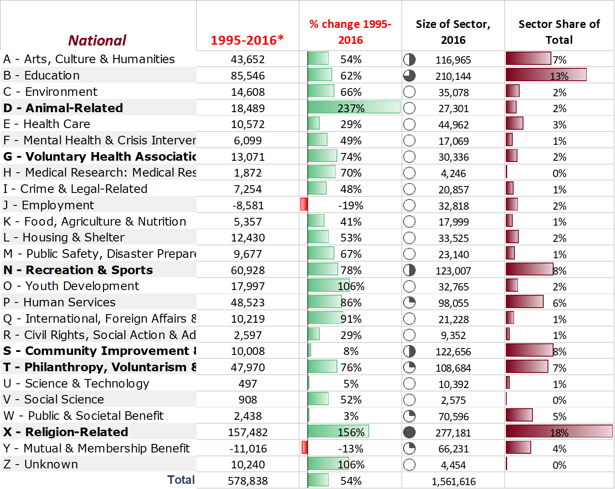

Slide 45
IMPLICATIONS

Slide 46
Population Per Organizational Role
Definition: Number of people each organization has available to them to locate a positional leader.
Yes, people serve on multiple boards.
Assumption of 3 per board is conservative.
Age 18+ includes many age groups that are less active.

Slide 47
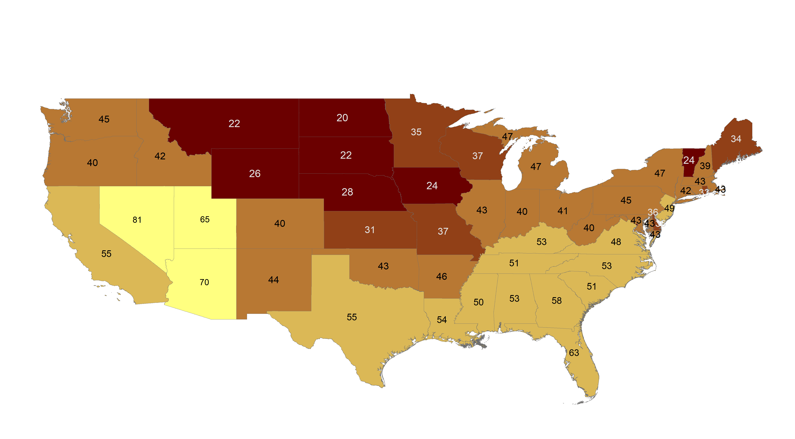
Population per Organizational Role, 2010

Slide 48
Opportunities for Engagement
New residents are more than warm bodies
Younger people (Millennials age 18-34)
Decentralized approaches to leadership
Simplified methods of communication
Generational interests change yet organizations do not
Start with a small request
Engagement before leadership

Slide 49
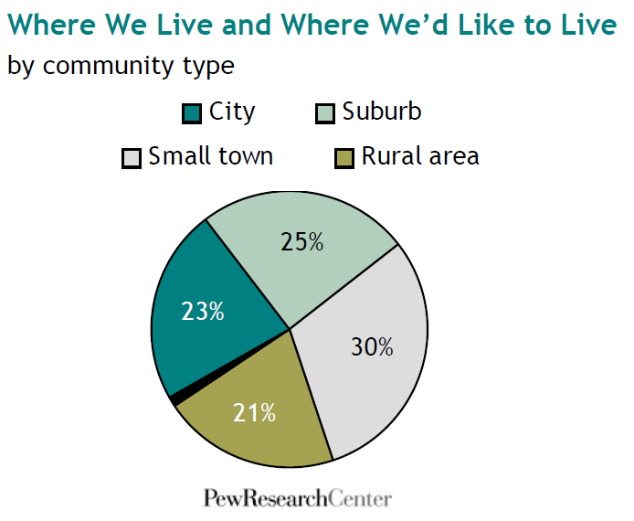
20% live rural/small town
51% would PREFER to
MOVING IN : Demand for rural and small town living!
Source: “For Nearly Half of America, Grass is Greener Somewhere Else”. Pew Research Center, 2009.

Slide 50
Reframing Rural Migration
National societal preferences to live in small towns and rural places (low-density)
Not everyone is leaving small towns
It’s a lot of work to make this move but people are doing it
Not everyone is flocking to the city
Most urban have gotten wider, not taller
A new urbanity is found in formerly rural places

Slide 51
Migration and the Narrative
Migration patterns open the door to discussing the narrative
There are varied reasons for people to move to small towns and rural places

Slide 52
Prepare for one of the largest
demographic changes to rural
America since 1930

Slide 53
75% of rural homeowners are
Baby Boomers and older.
30% over 70 today!
Notes:
Moving in – moving out – moving over
We want people to move over instead of moving out.

Slide 54
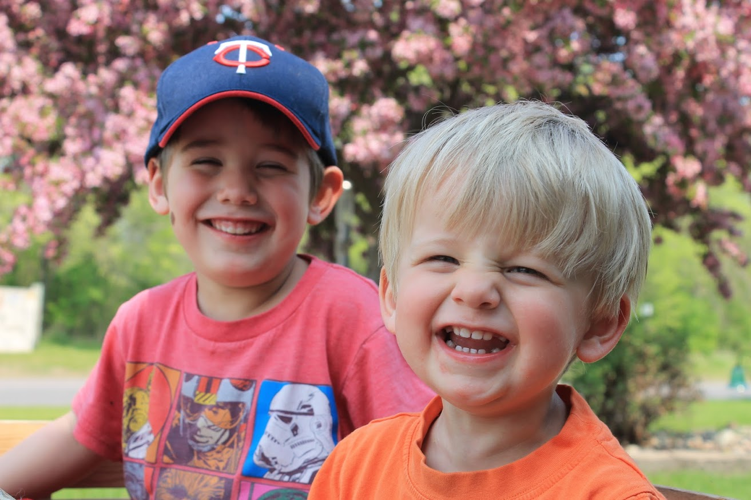
Narrative Matters
You’re not really from here….

Slide 55
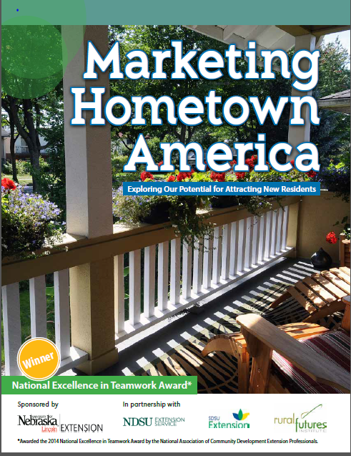
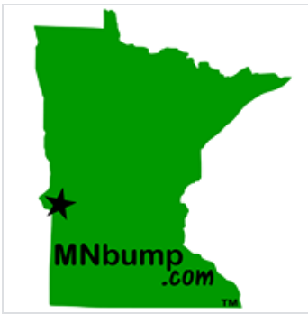
Resident Recruitment Efforts
In Minnesota

Slide 56
The Rural Choice
These newcomers are:
Creating groups, building their community
Diversifying the economy
Buying/starting businesses, working from home
Living in a region (no longer a 1-stop-shop)
More than warm bodies (employee recruitment)
Notes:
The new economic development narrative therefore has to be people focused at least as much as it is industry and business focused. It is going to be decentralized. It is going to involve diversified occupations and industries and it is going to take into consideration self-employment and multiple job holding because that’s the reality of rural places.

Slide 57
The Rural Choice: Opening New Doors and Welcoming New Neighbors
The bottom line is people WANT
to live and move here for
what you are today and will be tomorrow,
not what may have been!
Rural Revitalization is Upon Us!
Notes:
The new economic development narrative therefore has to be people focused at least as much as it is industry and business focused. It is going to be decentralized. It is going to involve diversified occupations and industries and it is going to take into consideration self-employment and multiple job holding because that’s the reality of rural places.

Slide 58
Brain Gain Landing Page
http://z.umn.edu/braingain/
Reddit: Rural By Choice
/r/ruralbychoice
Rural Issues and Trends Webinars
http://z.umn.edu/ruralwebinar/
benw@umn.edu

